Slide 1
Benefits of a Dedicated Medical Coordination Center and Incident Command System
Presenters:
Katie Puskar and Luke Aurner
Copyright 2022. All rights reserved.

Slide 2
Benefits of a Dedicated Medical Coordination Center and Incident Command System
Presented by:
Katie Puskar
Healthcare Preparedness Analyst
Michigan Department of Health and Human Services
Luke Aurner
Coordinator
Michigan Region 6 Healthcare Coalition

Slide 3
Disclaimers
We have no conflicts related to this presentation.
The views and opinions of Michigan Region 6 Leadership are not necessarily those of others.

Slide 4
Question?
What is the number 1 cause of failure during an event or incident?
Communication

Slide 5
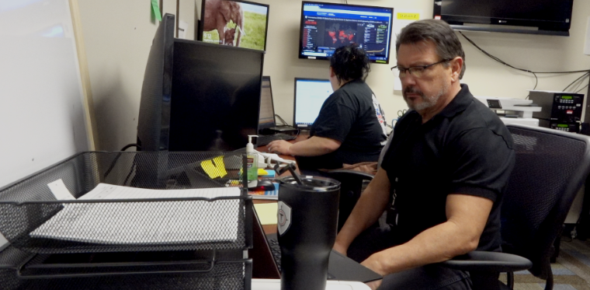
Why we decided to do this topic
Although we exercised, nothing like this has ever happened.
Many lessons learned.
Communication went well but could always be better.
Some of these changes are here to stay.

Slide 6
Objectives
Because our job is not to predict tomorrow based on yesterday, our job is to think outside the box and help healthcare overcome disaster.
Because in a response, there is a fog. History calls it a fog of war. War does not have to be people fighting against each other. War on drugs. War on COVID

Slide 7
Objectives
Discuss the relationship between the Michigan Department of Health and Human Services and the Region 6 Healthcare Coalition
Describe the functions and responsibilities of the CHECC.
Describe the functions and responsibilities of the Michigan Region 6 Medical Coordination Center.
Describe the benefits of a regional medical coordination center and the modifications needed to ICS.
Examine the use of technology to collaborate and communicate and how it has changed the way we respond.
Identify other ways a dedicated MCC can assist regional partners.

Slide 8
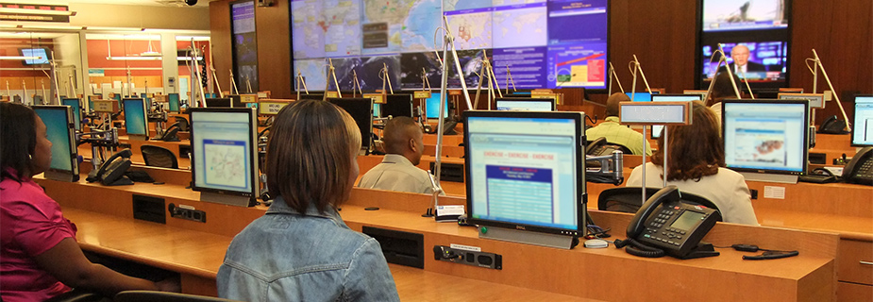
Coordinated Communications
Federal
Notes:
CDC Command Center.

Slide 9
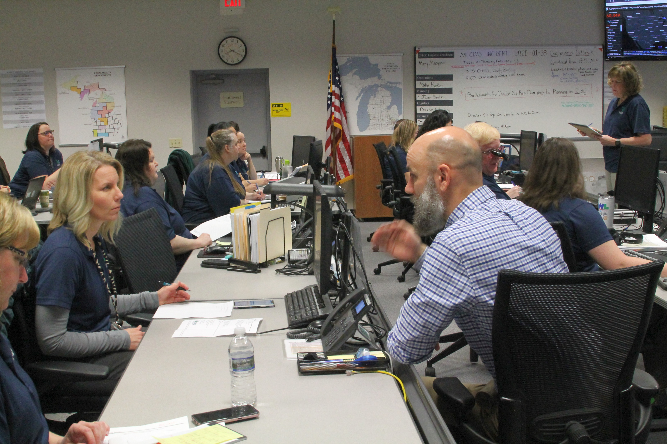
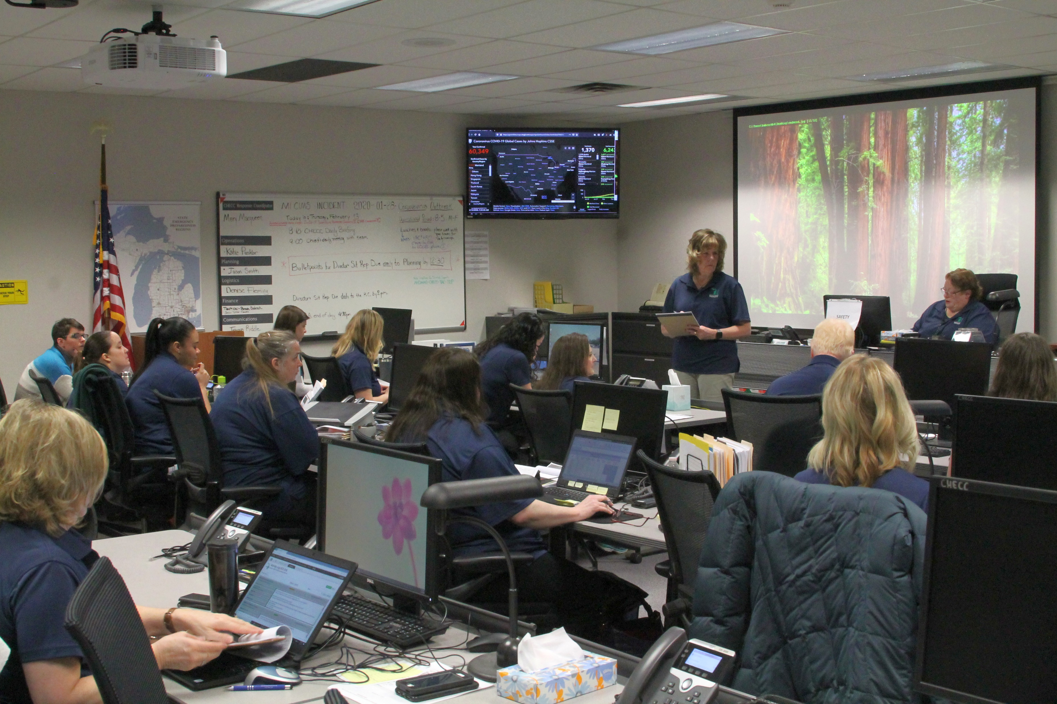
Coordinated Communications
State

Slide 10
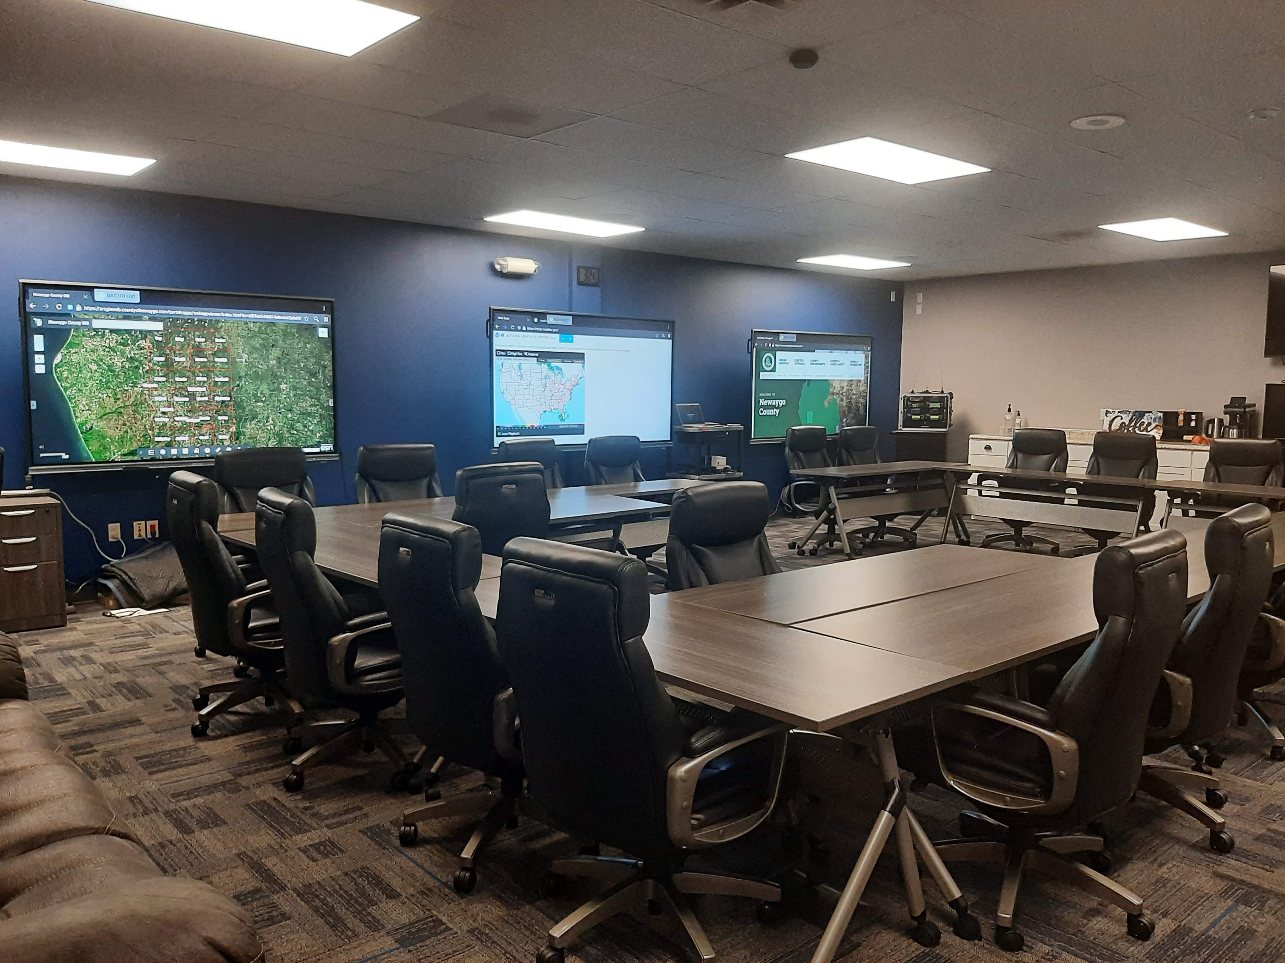
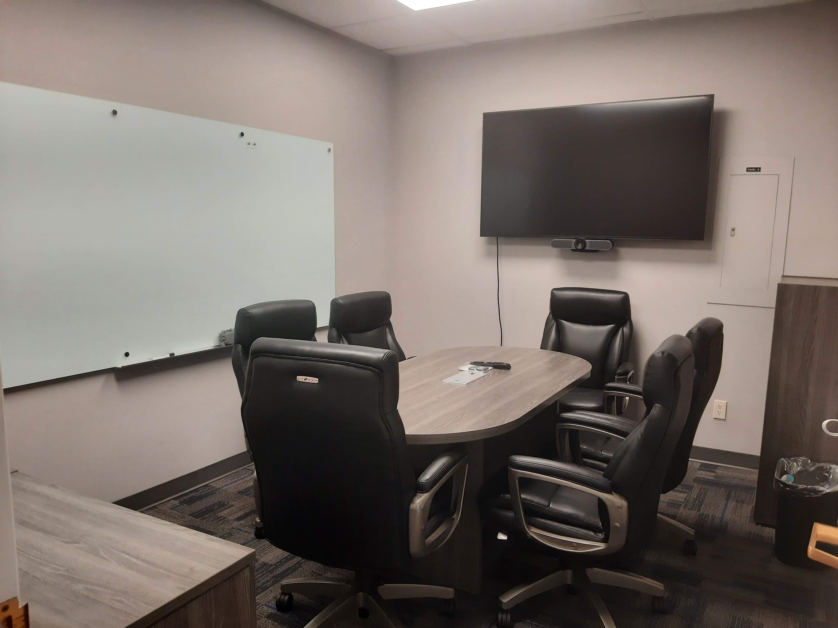
Coordinated Communications
Local

Slide 11
Coordinated Communications
Worldwide

Slide 12
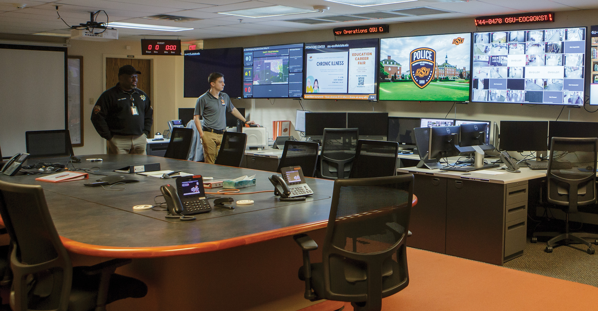
Coordinated Communications
Private Organizations
OSU EOC
Notes:
Oaklahoma State University EOC

Slide 13
The primary function of the CHECC is to support the State Emergency Operations Center (SEOC) by providing real-time public health information, subject matter expertise, and strategic countermeasure distribution. The Bureau of EMS, Trauma, and Preparedness maintains and staffs the CHECC with Michigan Department of Health and Human Services employees and contractors.
Community Health Emergency Coordination Center

Slide 14
CHECC is also set up in ICS fashion and includes the State’s Bureau of Laboratory, Epidemiology, and Immunizations as well subject matter experts on pediatrics, LTCs, respiratory and ventilators, volunteers, EMS, and prehospital and fatality management.
Community Health Emergency Coordination Center

Slide 15
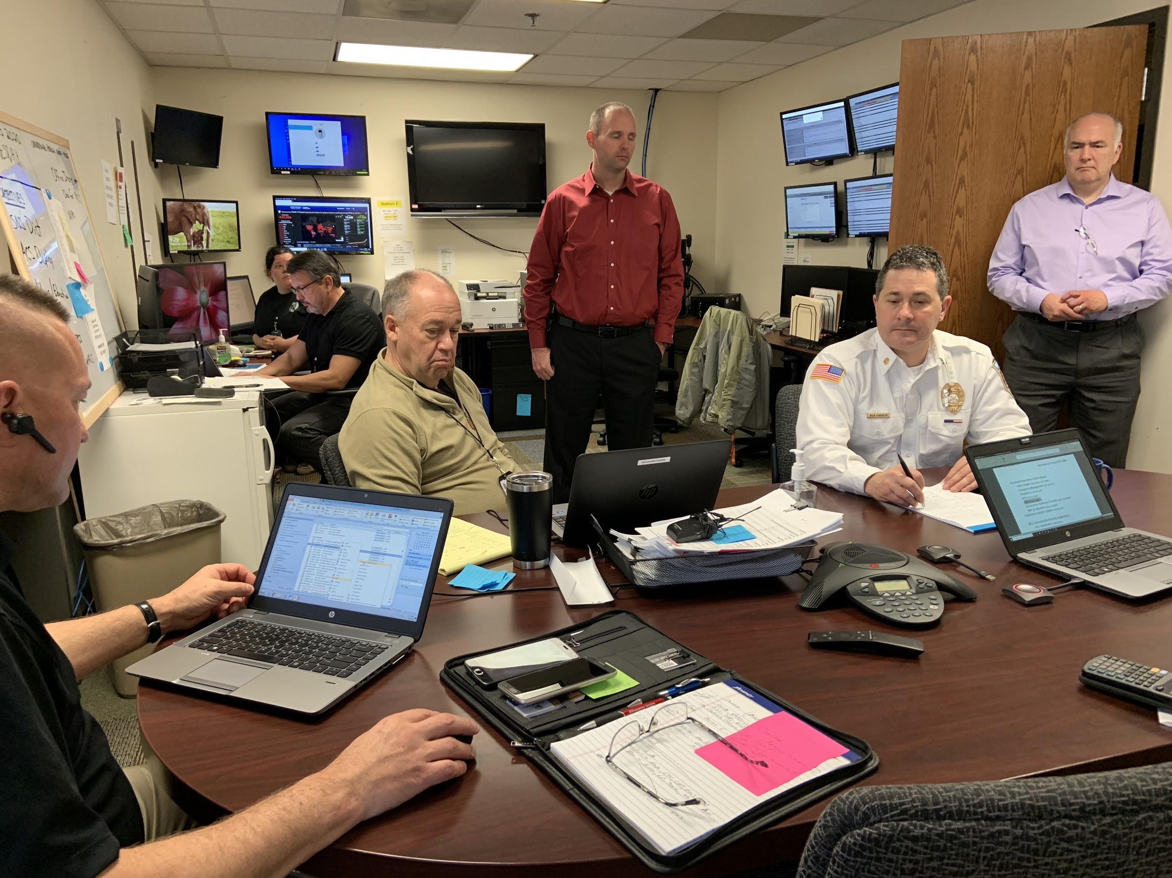
Region 6 Medical Coordination Center
Located at our Regional offices.
Shared space with Conference room
4 positions with computers and monitors.
Dedicated communications position
Flexible to meet the needs of the region
*Before mask mandates

Slide 16
Region 6 MCC
NOT command or control
But can back up that service if the event requires it.
*Before mask mandates

Slide 17
History of Michigan’s Preparedness Program
Established in 2002 funded by the Health Resource & Services Administration (HERSA)
Original structure was 1 coordinator and 1 part-time medical director per region.
An assistant coordinator was added later due to the size and complexity of the program
Regional boundaries set based on the already established State Emergency Management regions
Adapted to the ever-changing challenges of healthcare preparedness
Notes:
COVID proved the importance of the HCCs with their direct links to the health care entities. Daily calls at first with the state that frequency has slowed down over time but we still meet with the HCCs at least twice a month and individually more often than that. The regions have continued making contact with hospitals, LTC, Behavioral Health
Links to get PPE out to hospitals
Data input

Slide 18
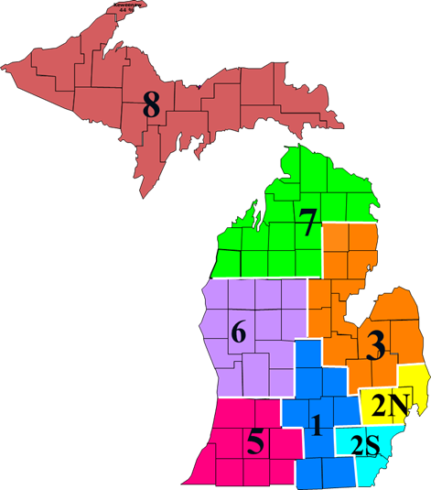
Regional Break Down
8 regions
84 counties
97,990 square miles
9.96 million people
181 hospitals including acute care, psychiatric and pediatric facilities
436 Skilled Nursing Facilities
Estimated 4,000+ Other nursing home types

Slide 19
Coronavirus Outbreak

Slide 20
COVID in Michigan
January 25: Three Michiganders are tested, although tests come back negative
January 29: Detroit Metro Airport begins screening for the virus
January 30: WHO declares a public health emergency of international concern as China reports thousands of coronavirus cases. The U.S. warns not to travel to China and the next day, the president suspends travel of foreign nationals from China
February 5: The CHECC is activated to prepare for the potential arrival of the virus
March 10: Gov. Gretchen Whitmer declares an emergency after confirming the state’s first two cases of the new coronavirus, an Oakland County woman and a Wayne County man tested positive
March 13: The President declares a national emergency.

Slide 21
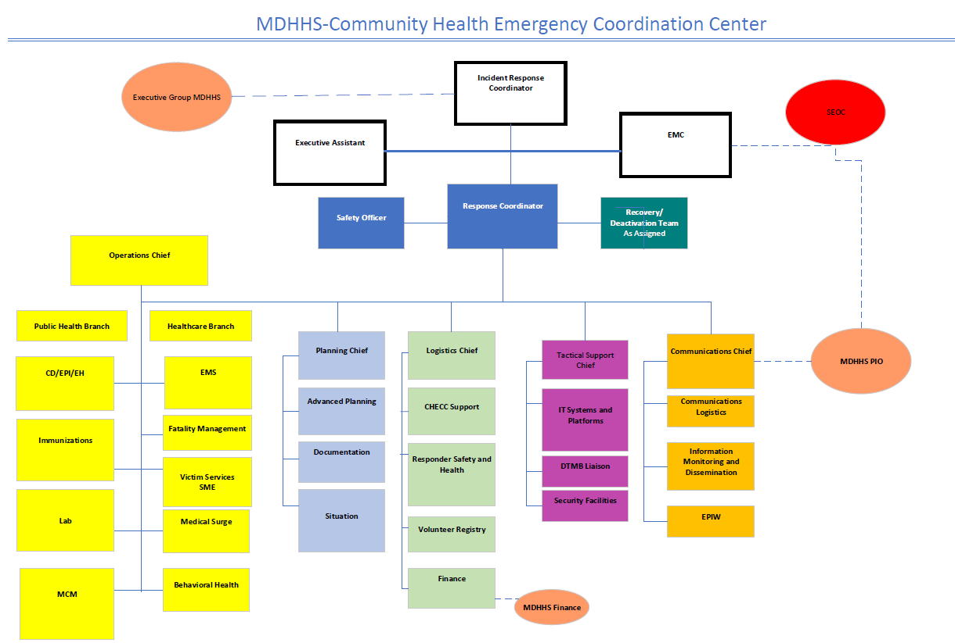
MDHHS’s Adaptation of traditional ICS

Slide 22
MDHHS’s Adaptation of traditional ICS

Slide 23
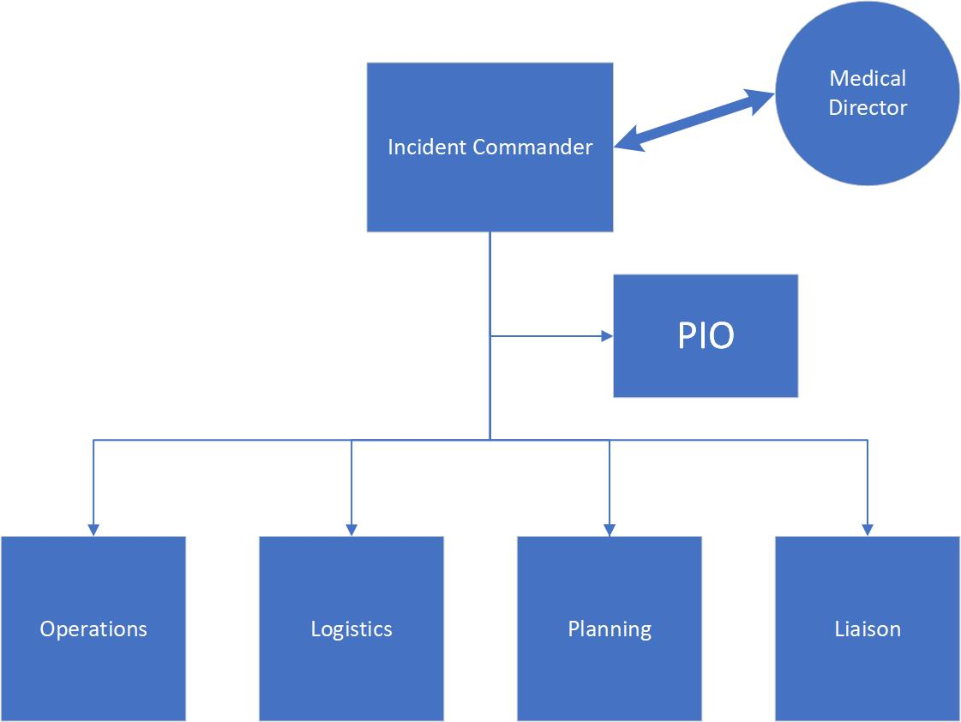
Region 6
Incident Command Structure

Slide 24
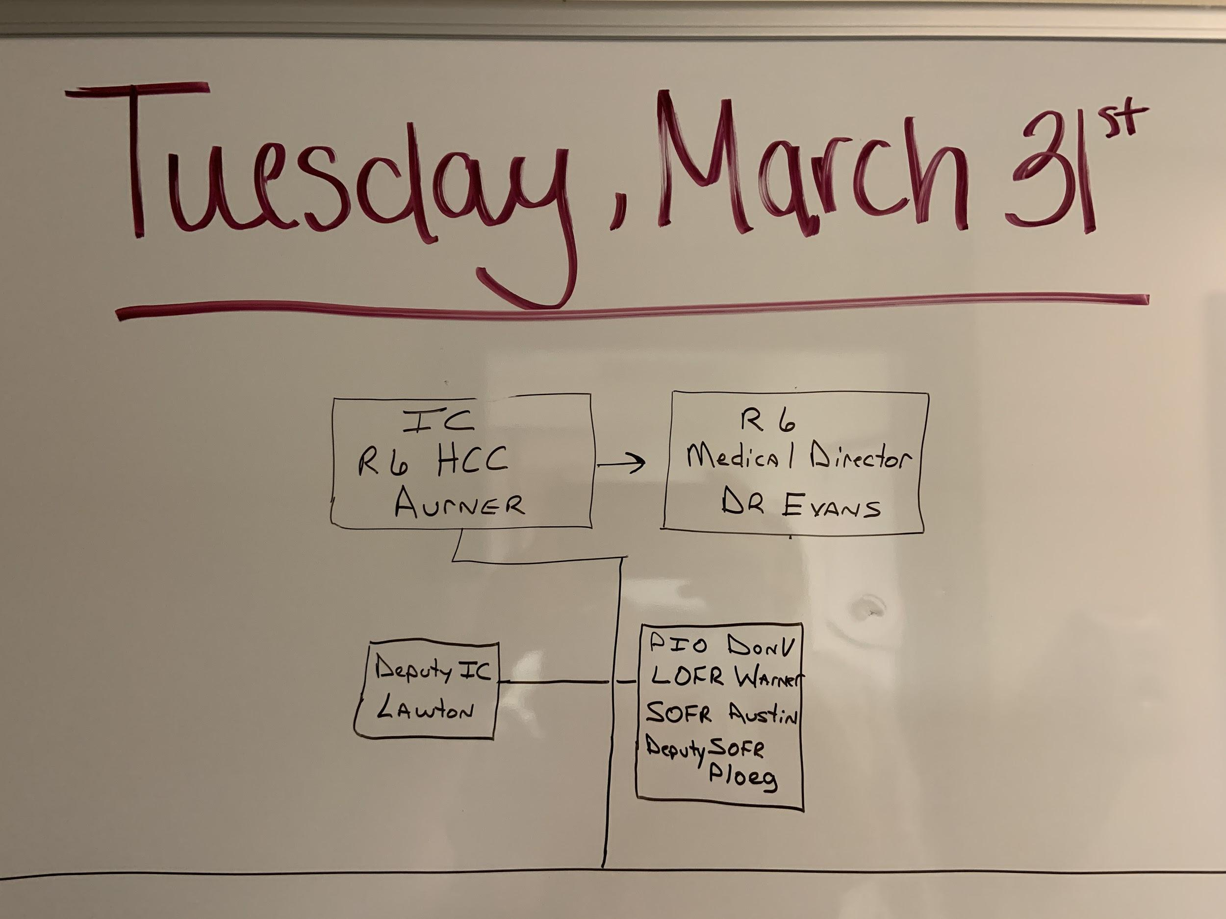
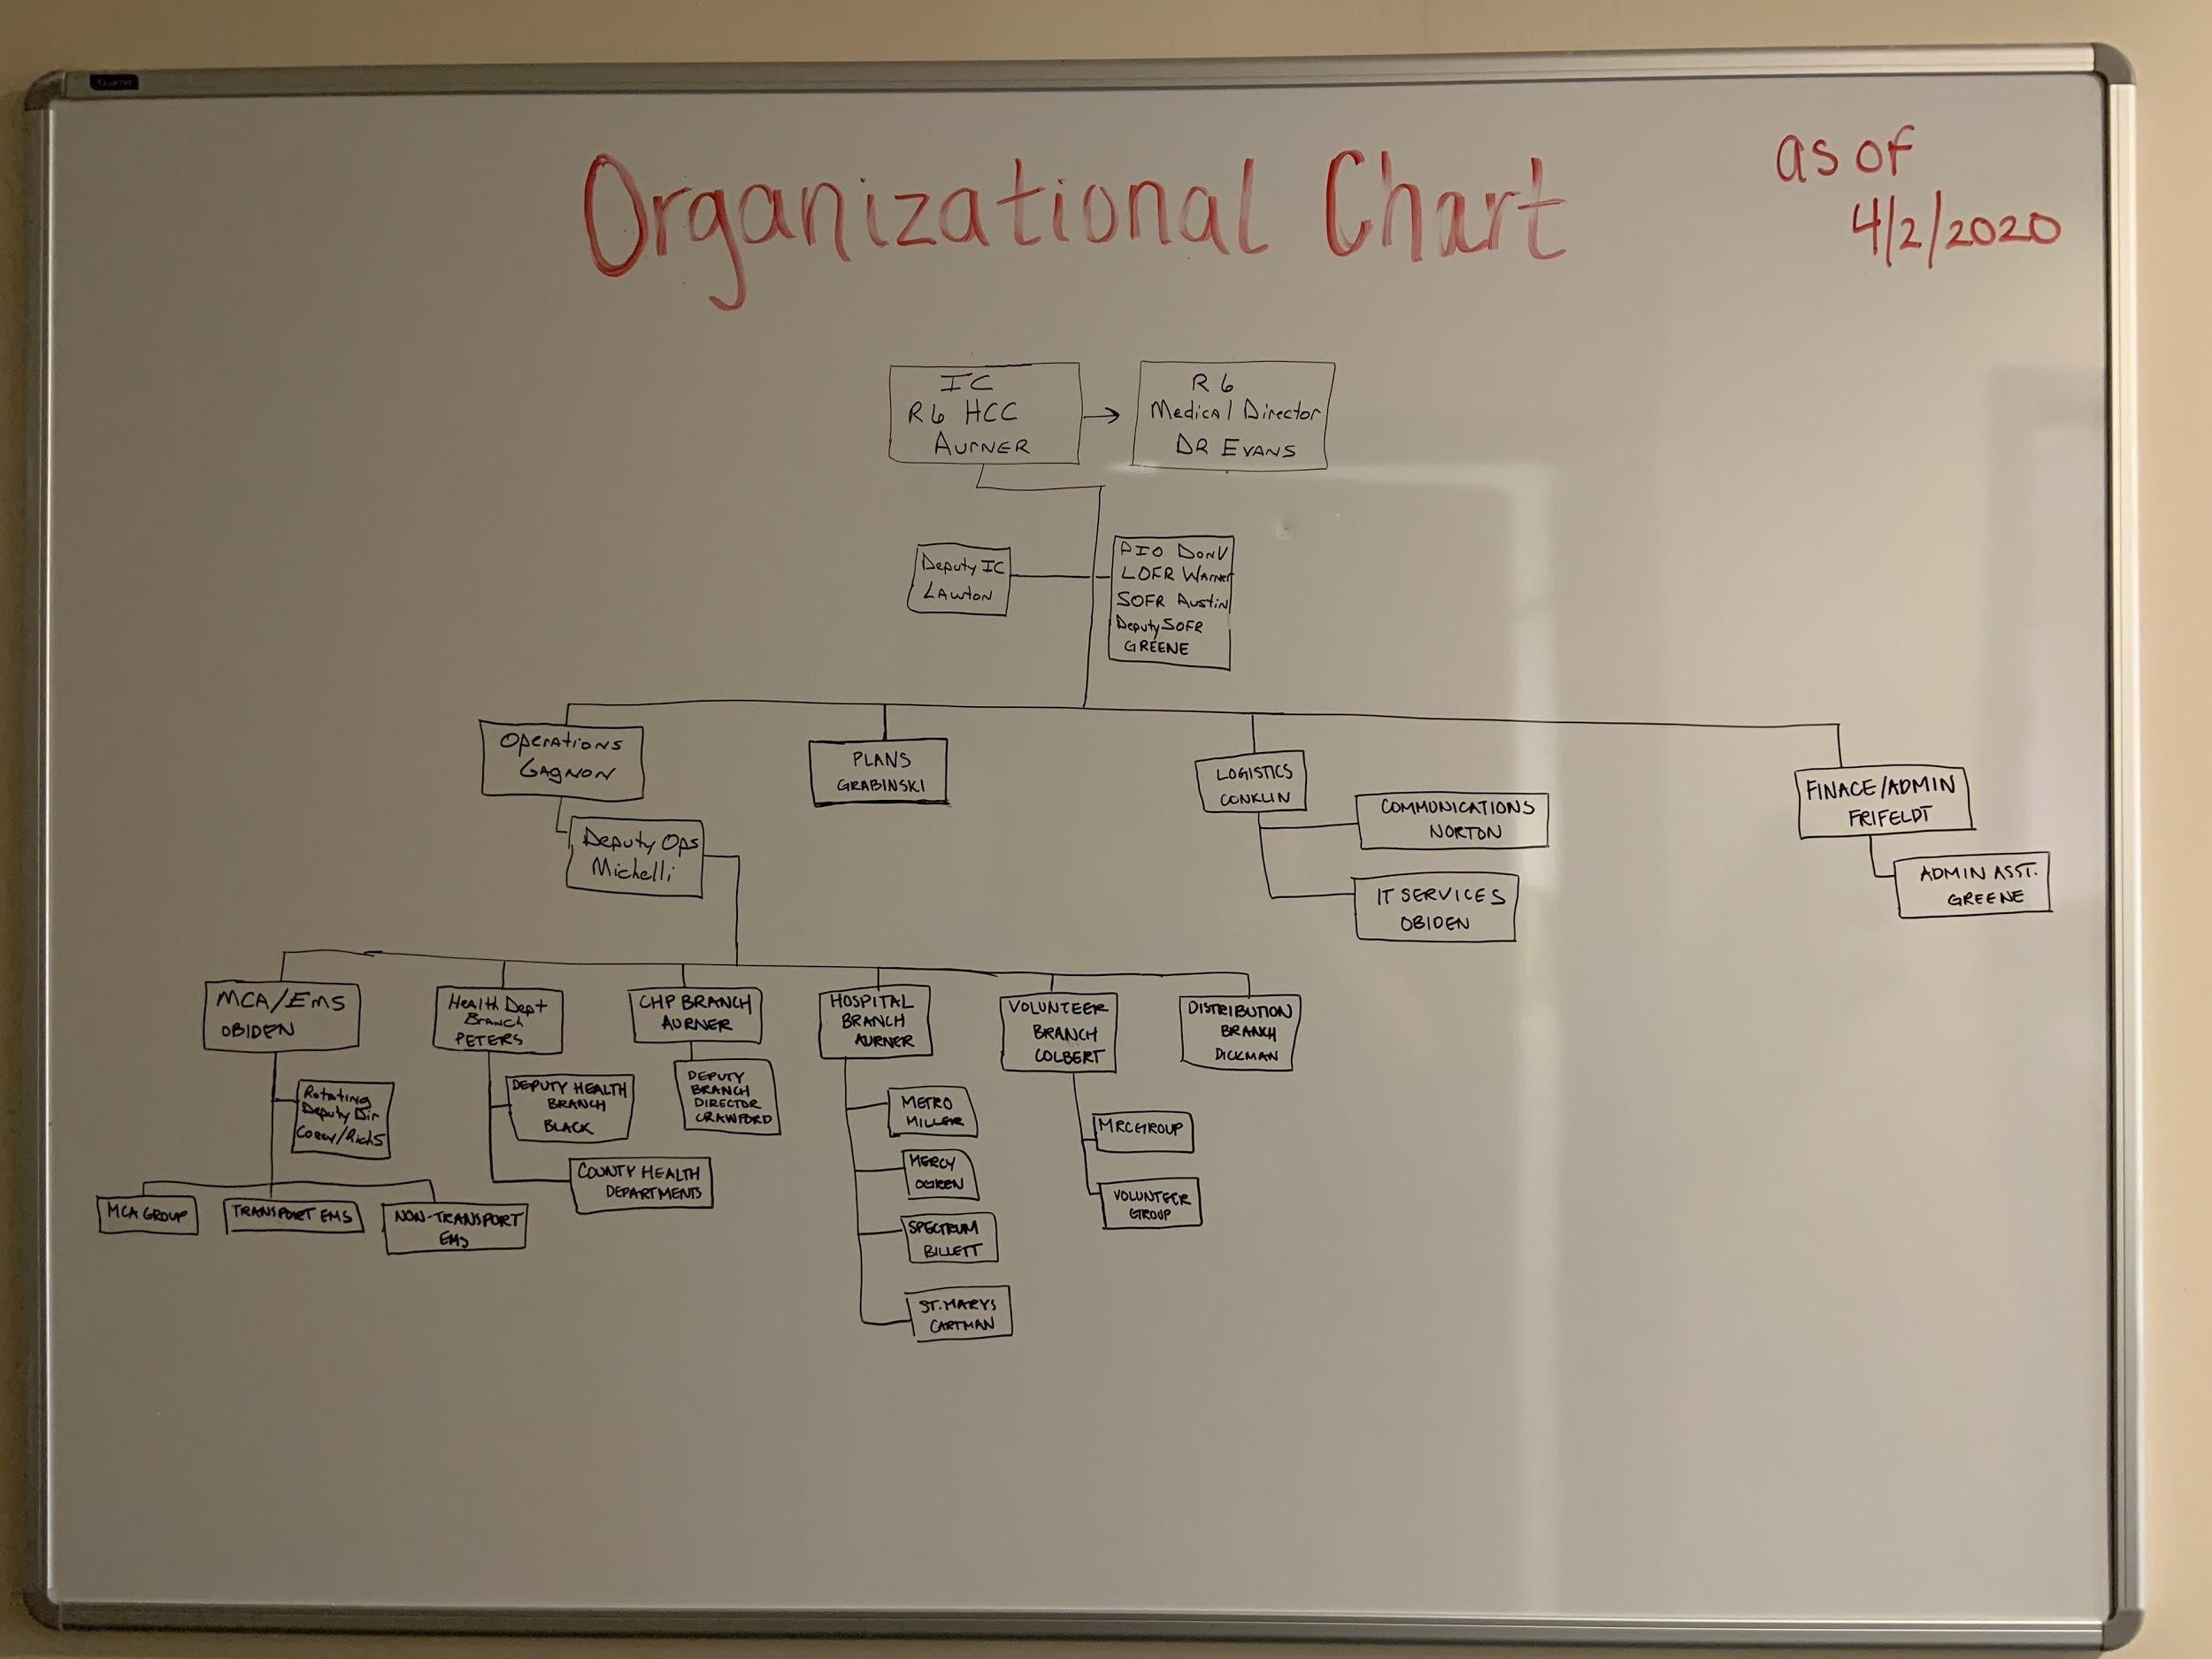
Region 6 Organizational Chart

Slide 25
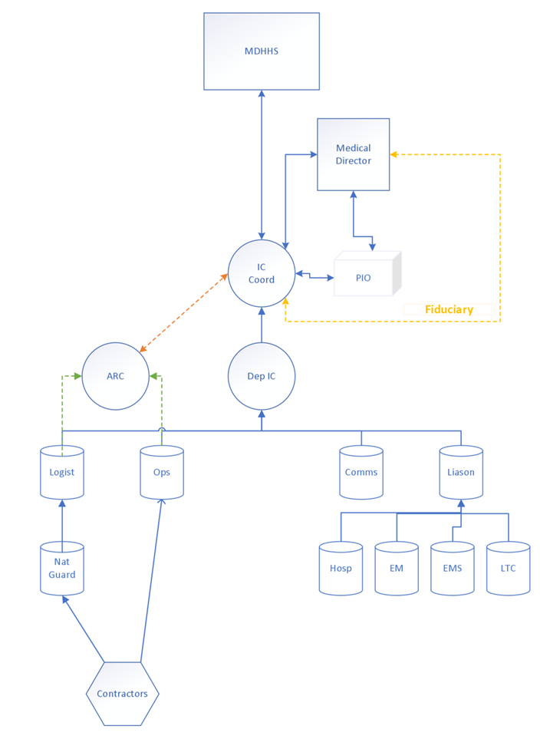
Incident Command
Reporting Structure - ish

Slide 26
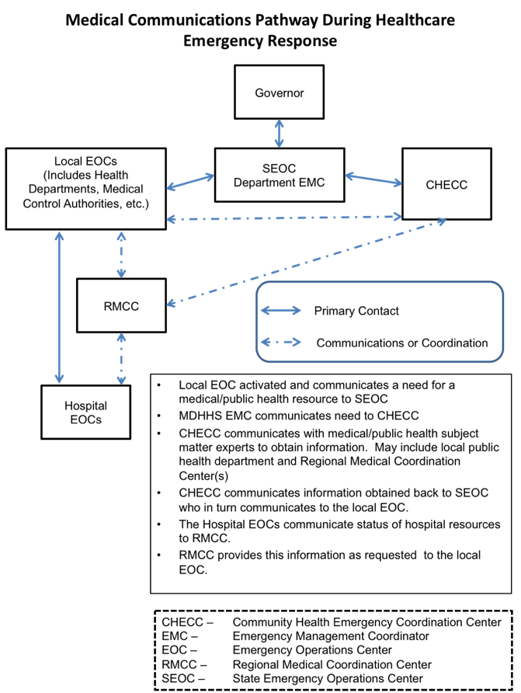
How it all Fits Together

Slide 27
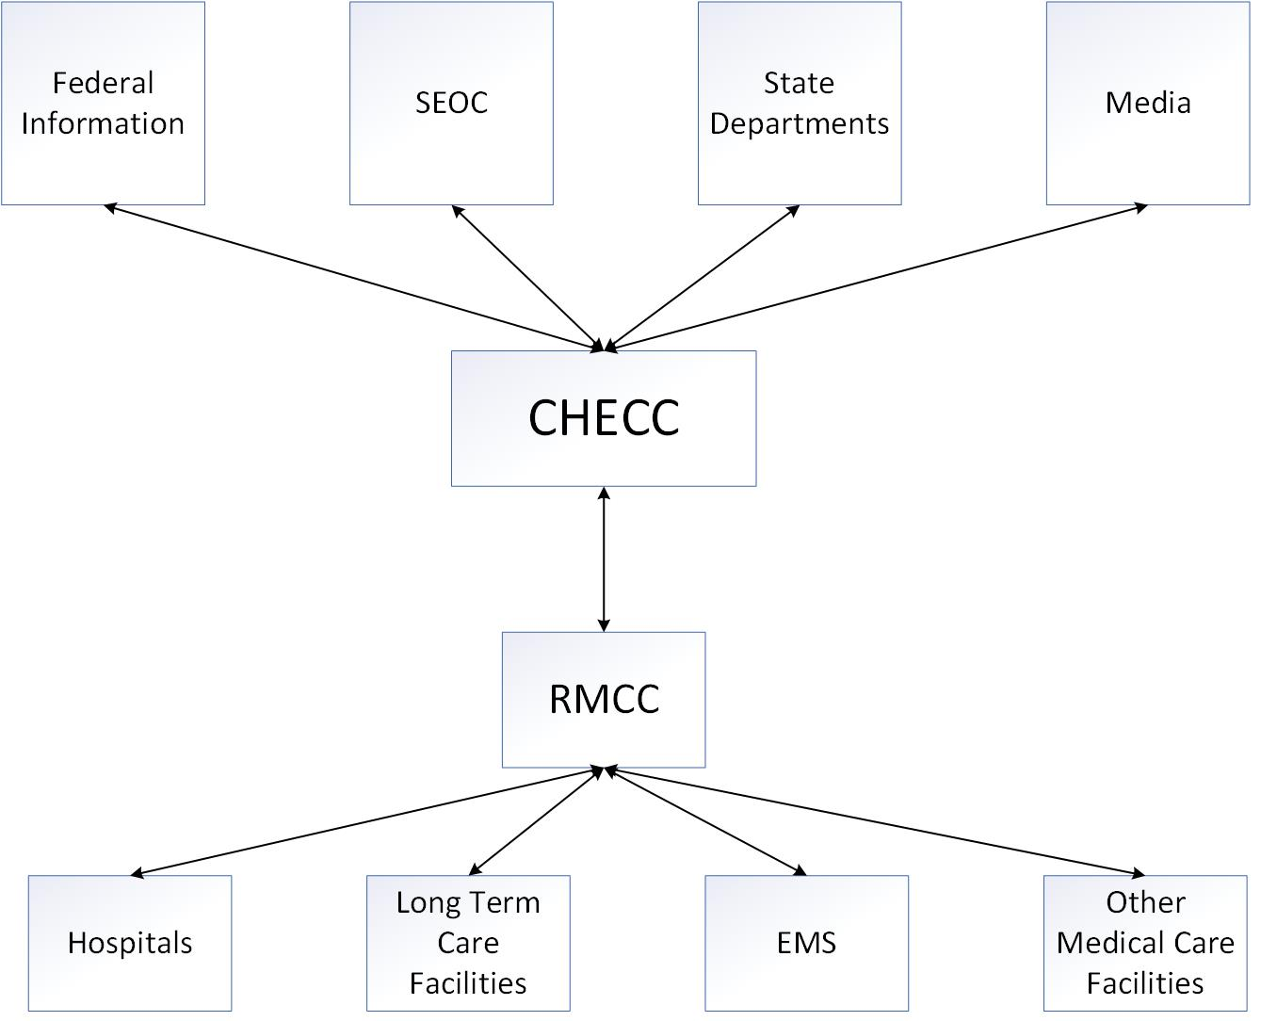
Traditional Flow of Information

Slide 28
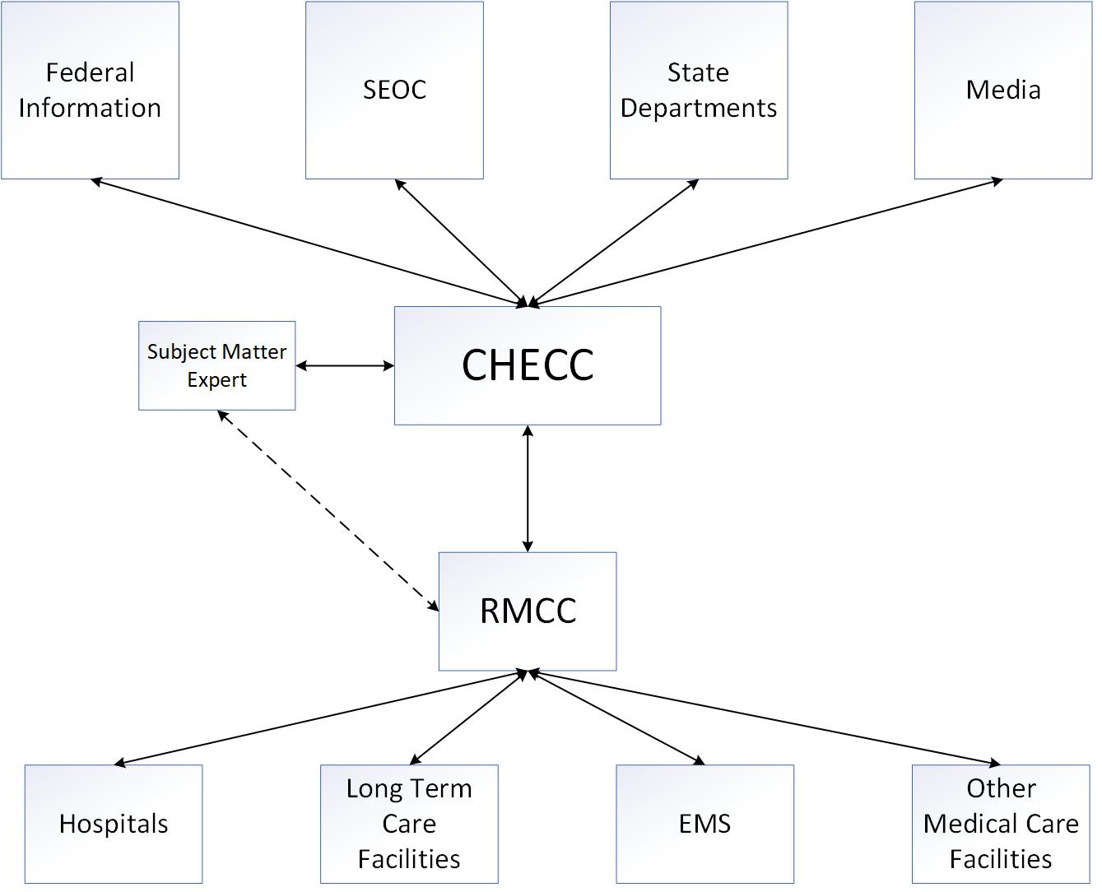
Modified Flow of Information

Slide 29
How many people do you think it takes to run a regional Medical Coordination Center?

Slide 30
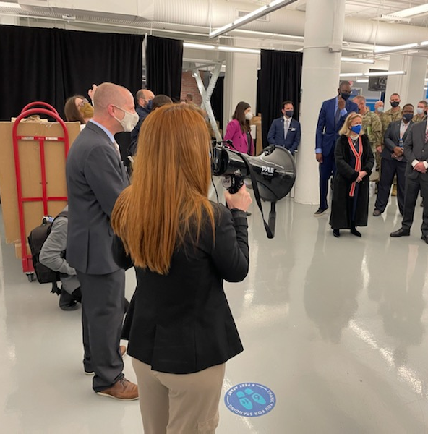
Public Information
CHECC houses the MDHHS Public Information Officer.
Information is pushed through the chain of command for full situational awareness.
Notes:
Early Accurate Often

Slide 31
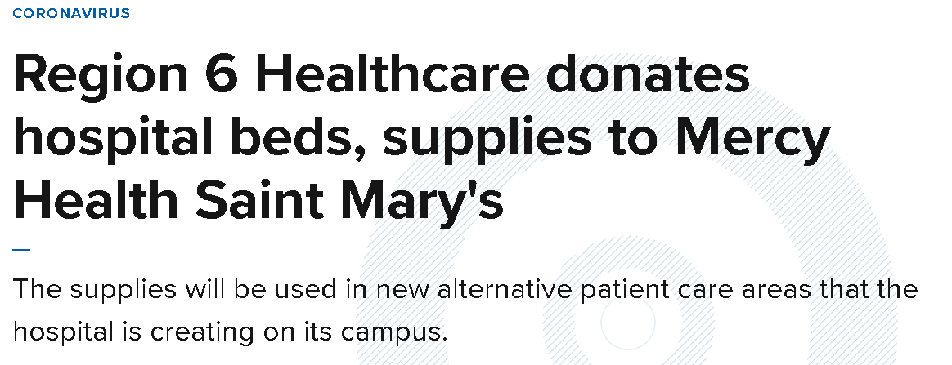
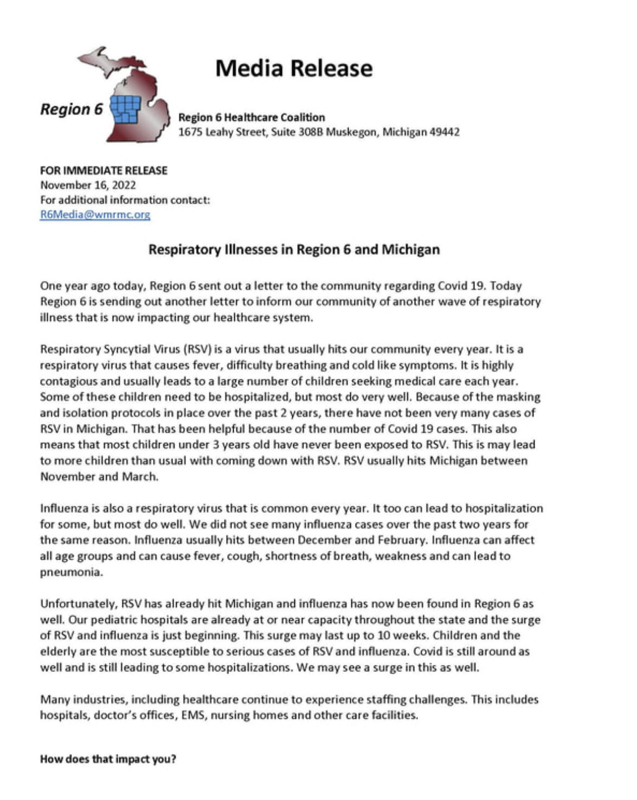
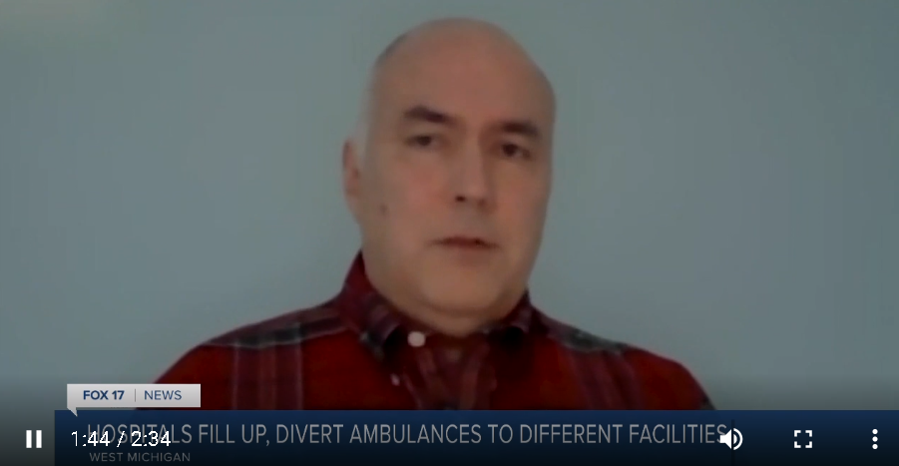
Public Information

Slide 32
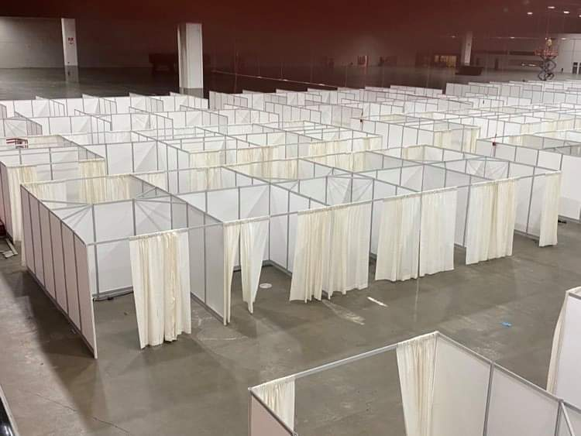
Alternate Care Sites

Slide 33
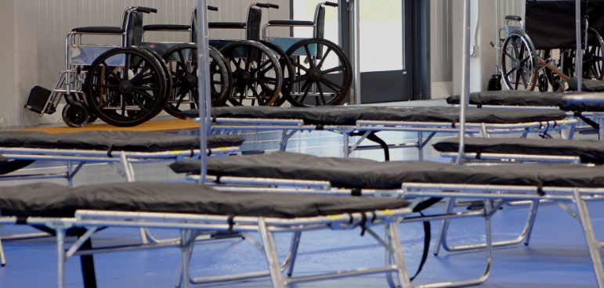
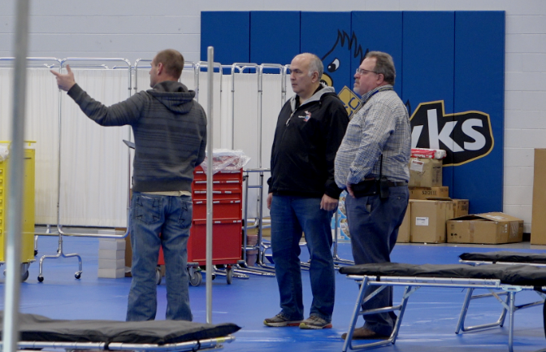
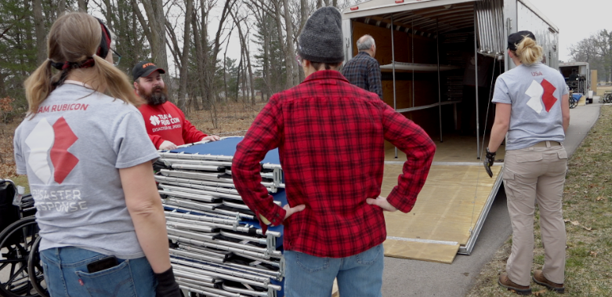
Alternate Care Site

Slide 34
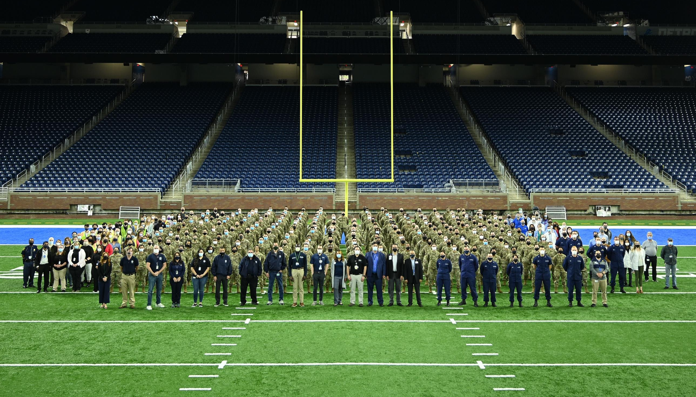
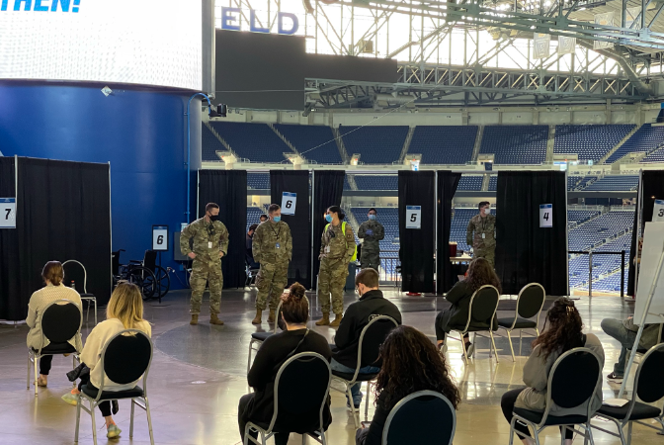
Ford Field Vaccine Clinic
Region 2 South

Slide 35
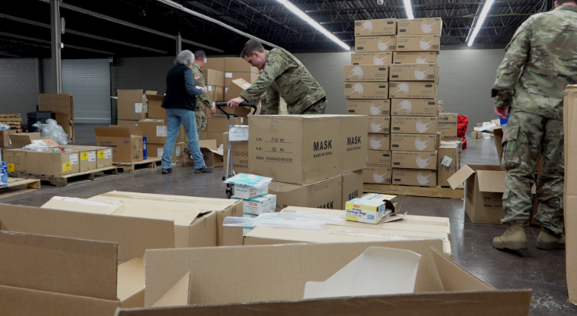
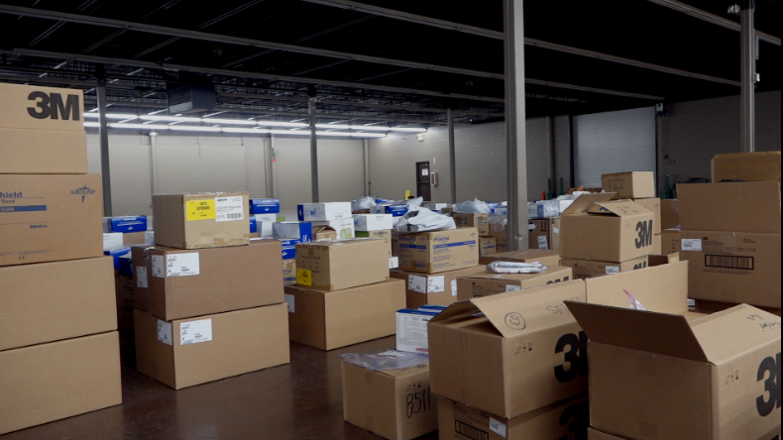
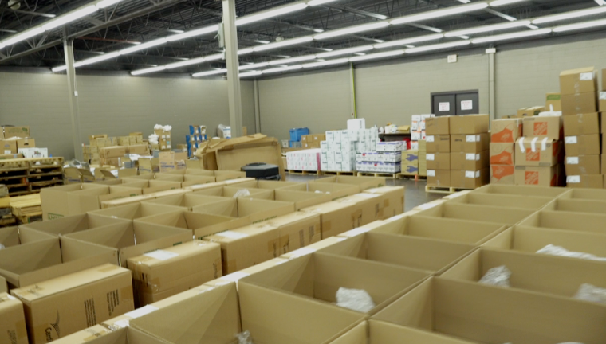
PPE

Slide 36
PPE

Slide 37
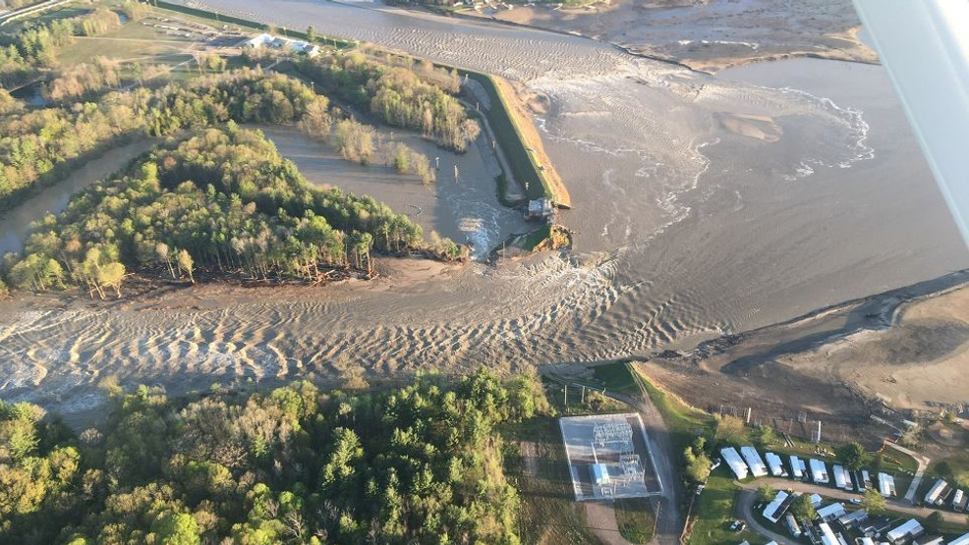
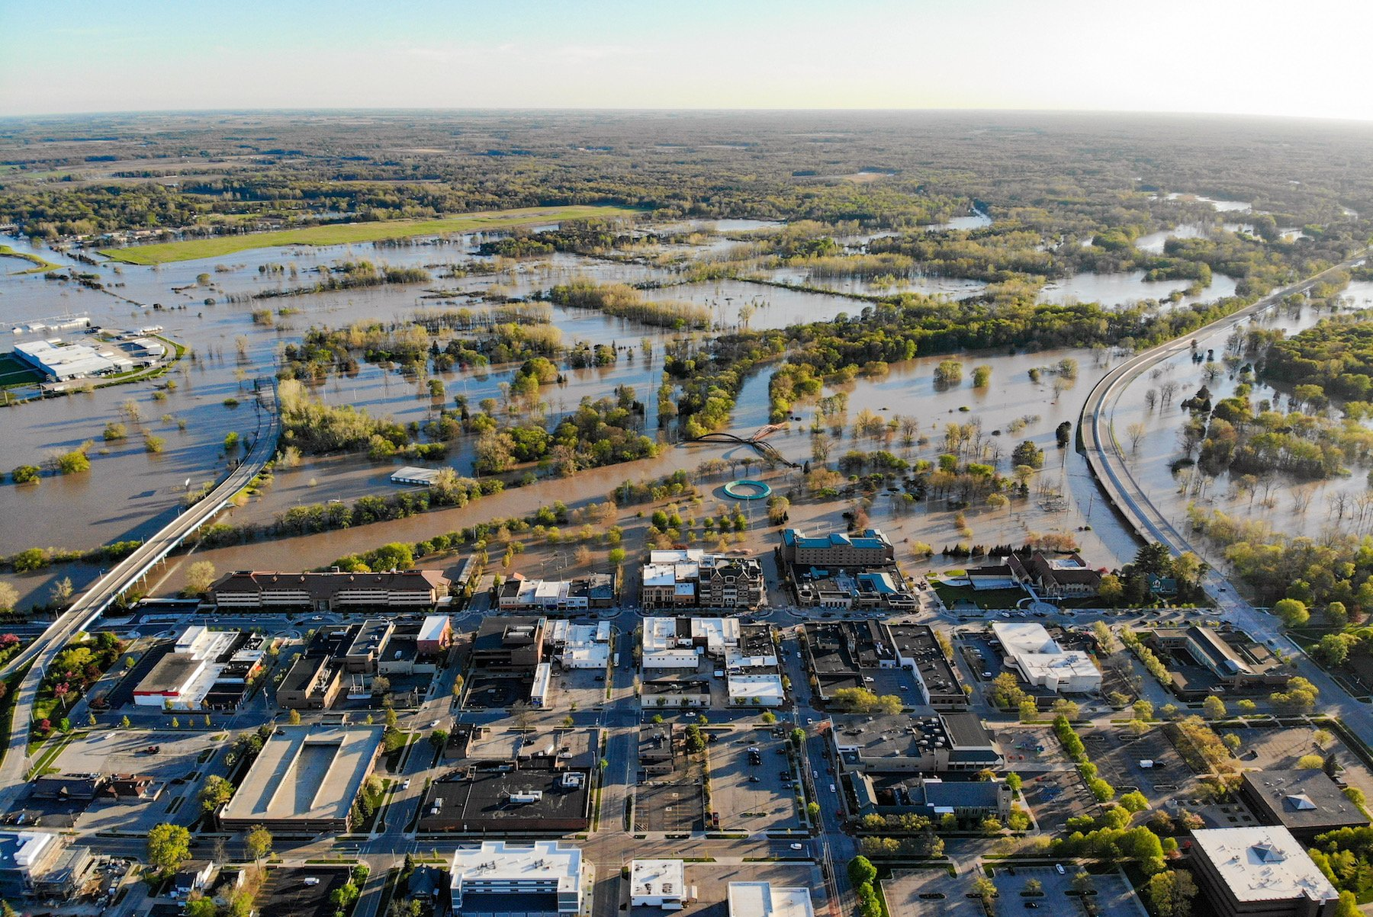
Midland Dam Failure
May 19, 2020- Edenville Dam Failed threatening thousands of lives and property.
Facilities Effected:
1 Hospital
Multiple Nursing Facilities
Dow Chemical Plant

Slide 38
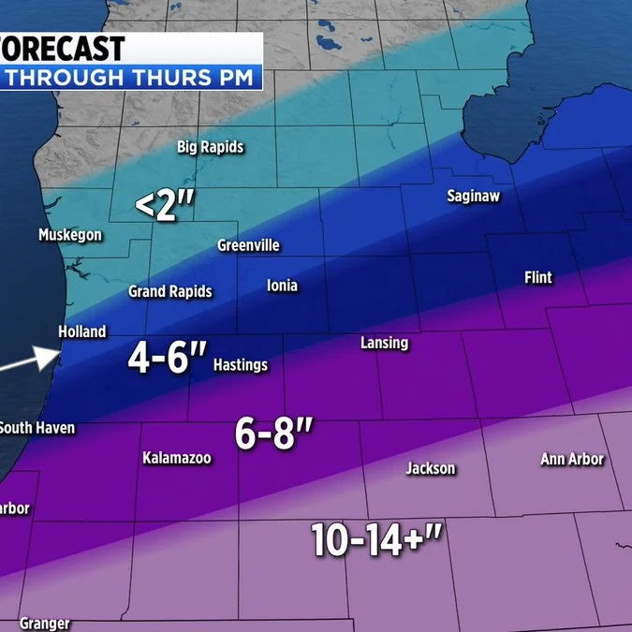
Weather

Slide 39
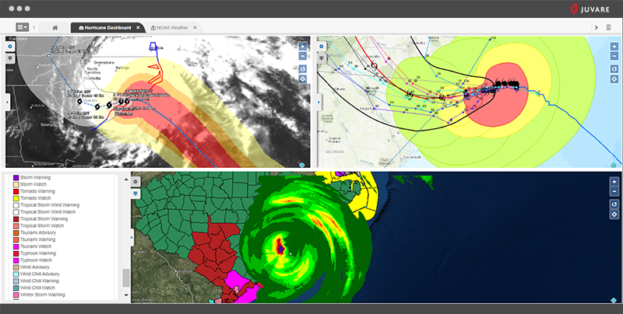
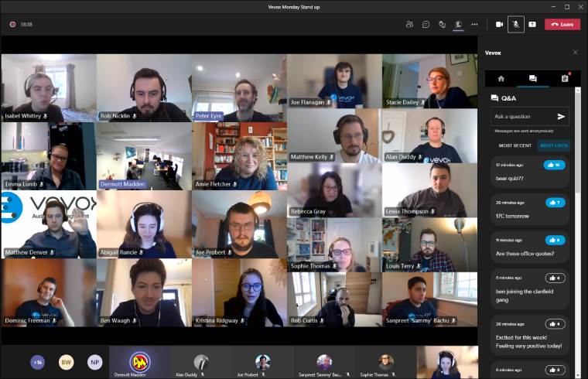
Technology
It has all changed

Slide 40
How has technology changed the way we respond in Michigan Region 6?

Slide 41
Add additional people to meeting as needed
No travel costs or time needed
Easier to reach large crowds
Easier to Multitask
Pros of Technology

Slide 42
Cons of Technology
Easier to Multitask
Meeting Fatigue
Back to Back Meetings
Learning Curve:
Online meeting etiquette
New meeting platforms
Dependent on Power and Internet Connections
Missing Human Contact

Slide 43
Remote work and the Incident Command Structure
Needs to be adapted.
More flexibility
Communication backups
Expense of Technology vs. Expense of Space

Slide 44
Virtual EOC Best Practices
Establish activation, operation, and deactivation criteria, processes, and procedures with all virtual EOC partners and participants.
Define clear roles and responsibilities as part of an activated virtual EOC.
Conduct partner training and exercise in all relevant virtual EOC operations.
Ensure the requisite technology to support internet connectivity (web-based functions), voice and video conferencing, real-time status monitoring, alerts/notifications, and telecommunications, and mobile/radio communications are available and operational 24x7x365.
Monitor, track, report, and maintain other documentation on event status, personnel tracking, staging, deployment, and tracking of resources.
Incorporate lessons learned in ongoing comprehensive virtual EOC planning and coordination
Ifac.org/docs

Slide 45
Tips and Tricks
Forms, Forms, More Forms
=
Documentation

Slide 46
Tips and Tricks

Slide 47
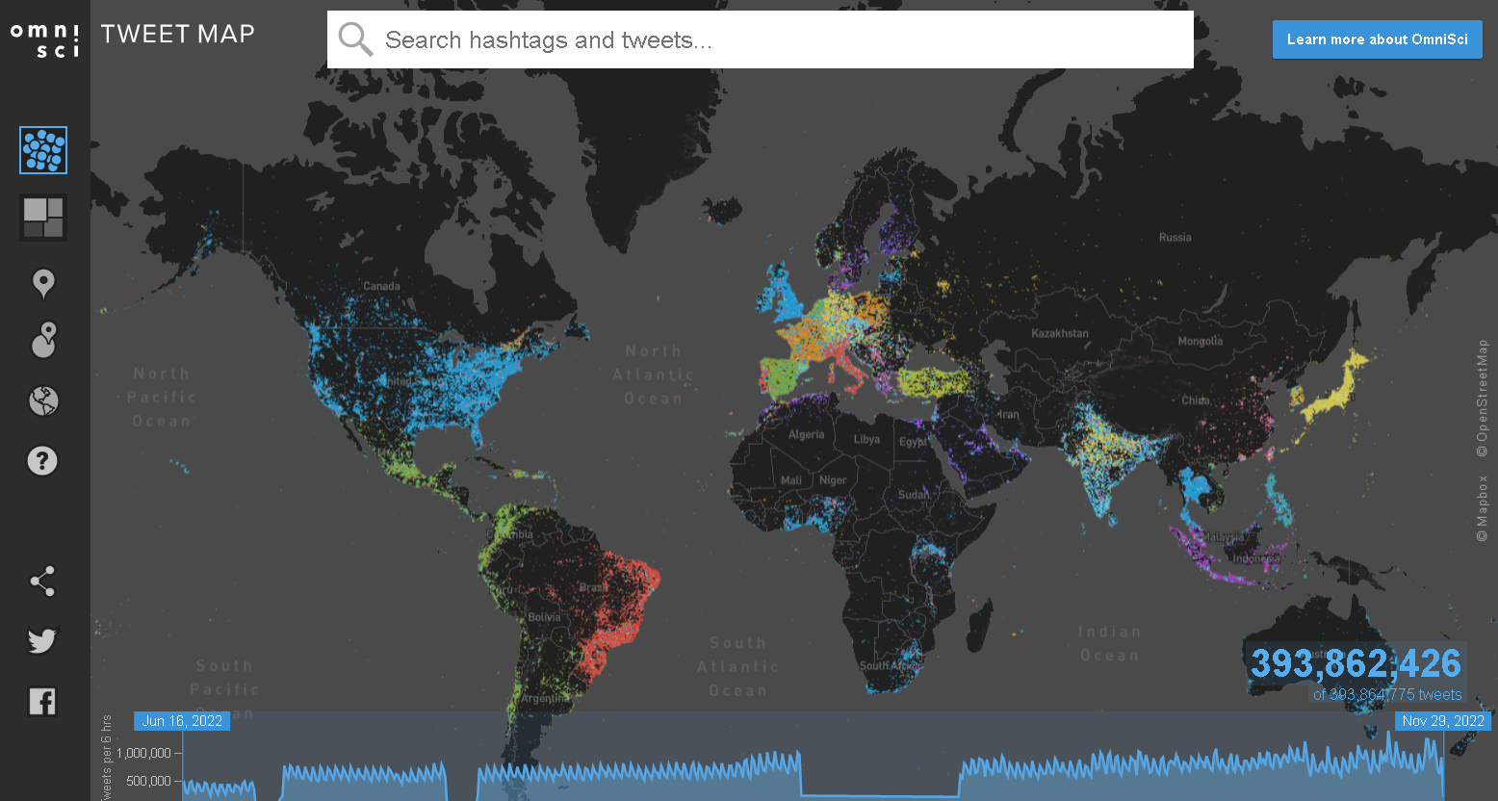
Tips and Tricks
TweetMap
Heavy.ai

Slide 48
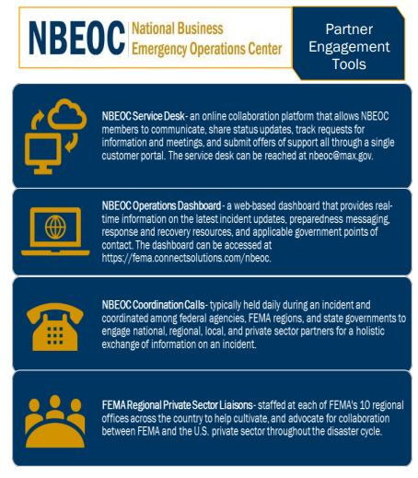
Tips and Tricks
National Business Emergency Operation Center

Slide 49
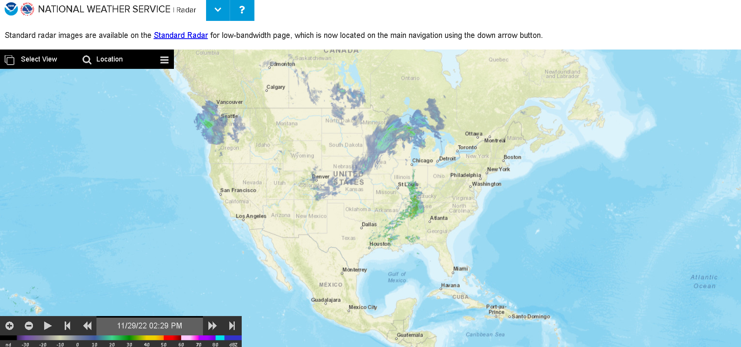
Tips and Tricks
National Weather Service

Slide 50
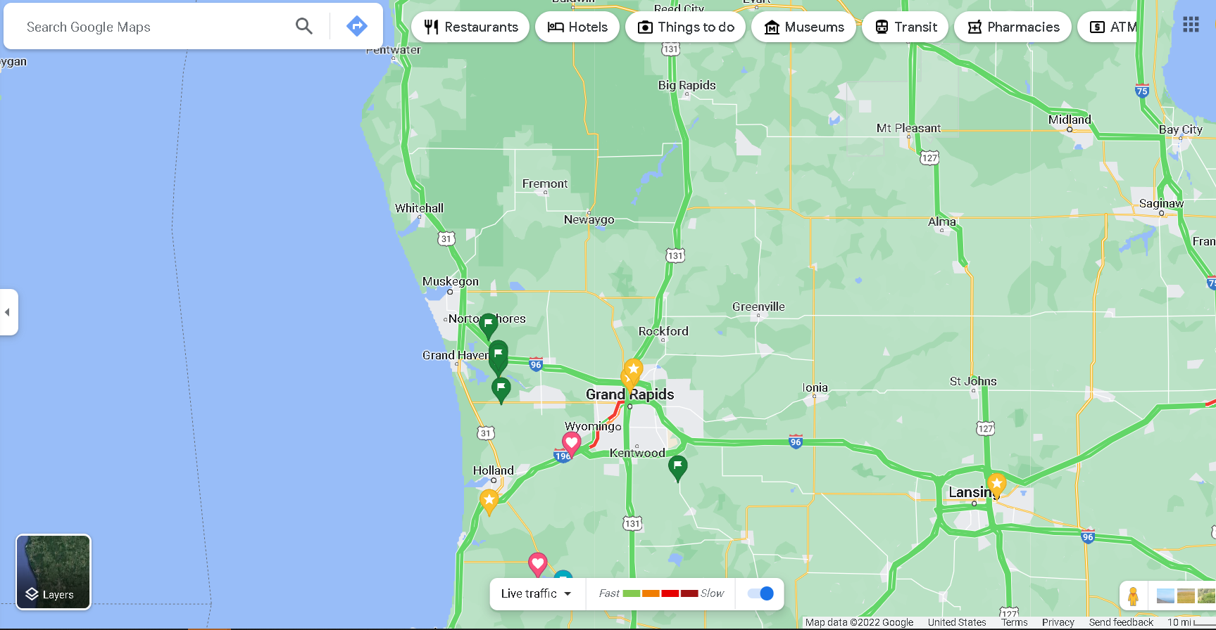
Tips and Tricks
GOOGLE MAPS

Slide 51
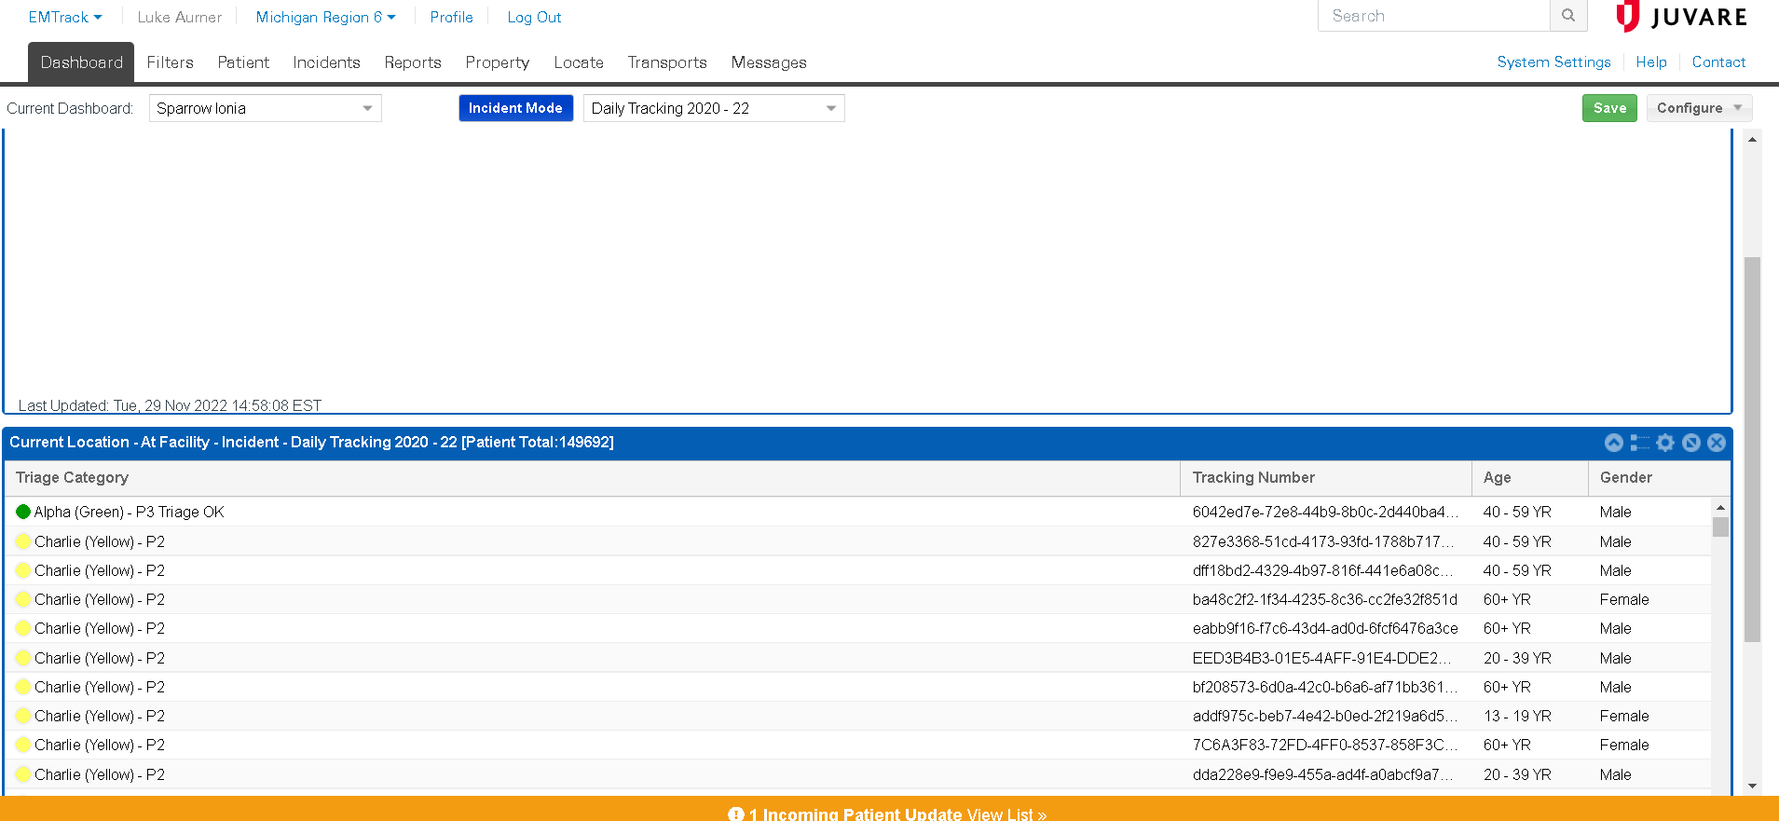
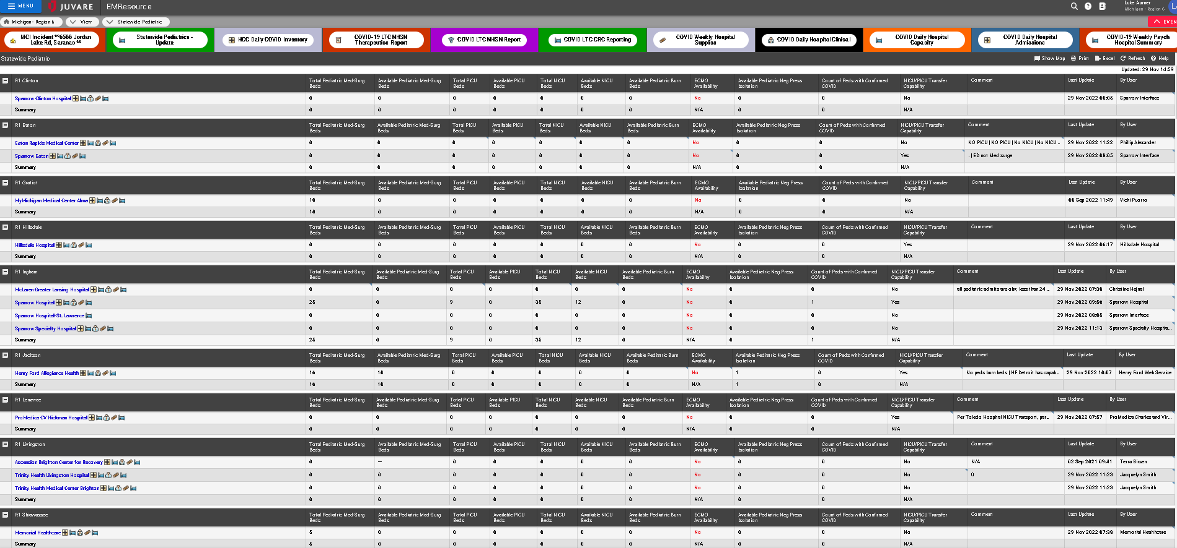
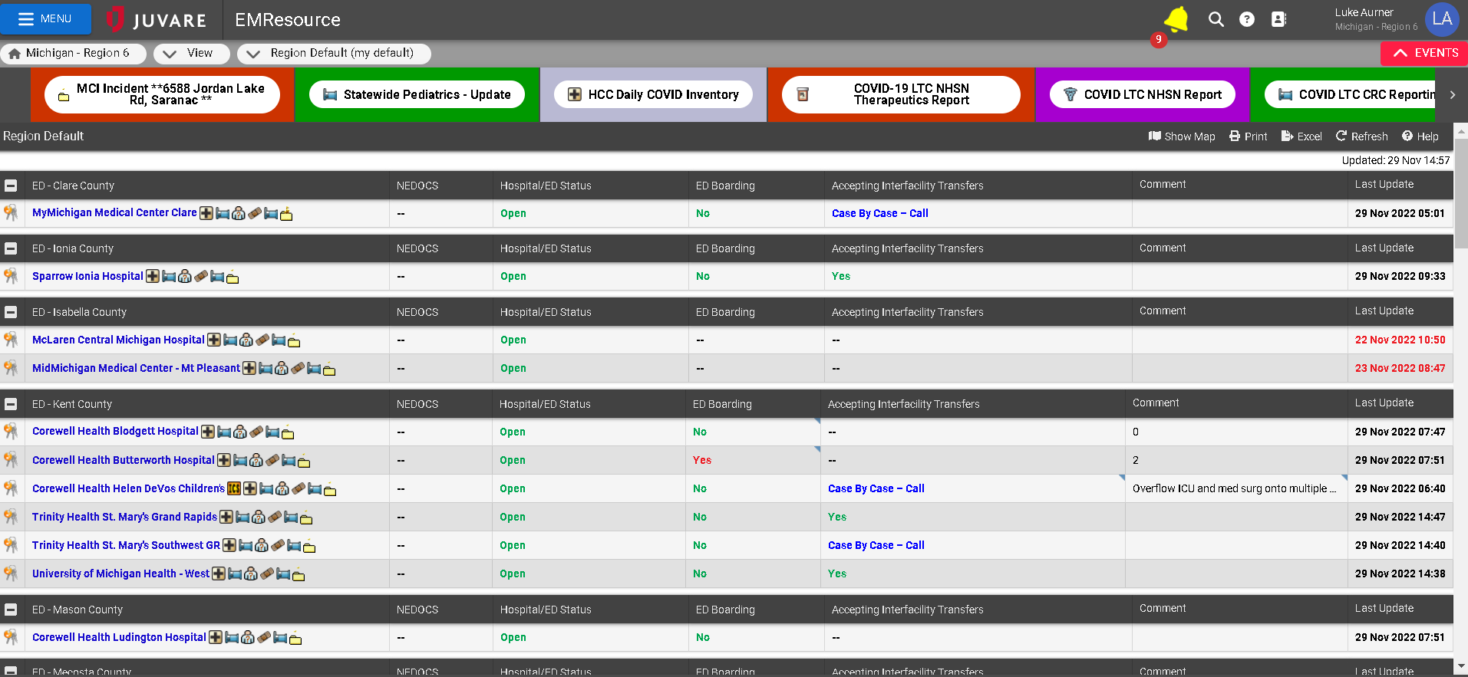
Tips and Tricks

Slide 52
Questions?
Katie Puskar
MDHHS
Disaster Preparedness Analyst
Email: puskark1@michigan.gov
Luke Aurner
MI Region 6
Healthcare Coalition Regional Coordinator
Email: laurner@wmrmc.org

Slide 53
