Slide 1
Michigan Guidelines for Implementing Crisis Standards of Care and Ethical Allocation of Scarce Medical Resources and Services During Emergencies and Disasters
State of Michigan
Michigan Department of Health and Human Services
Bureau of EMS, Trauma, and Preparedness
Notes:
The Michigan Guidelines for Implementing Crisis Standards of Care and Ethical Allocation of Scarce Medical Resources and Services During Emergencies and Disasters (Guidelines) represent an effort to develop useful guidance to help decision-makers make allocation decisions under conditions of scarcity that may arise during public health emergencies. The slides that follow describe the Guidelines in detail and discuss many of the ethical issues that may arise under these circumstances.

Slide 2
Overview
Crisis Standards of Care
National Guidelines – Institute of Medicine and National Academy of Medicine
Michigan Guidelines
Applicability
Goals
Ethical Considerations
Allocation Criteria
Michigan Specific Guidance
Notes:
The Guidelines arise from an ongoing project by the Michigan Department of Health and Human Services, Bureau of EMS, Trauma, and Preparedness.

Slide 3
Michigan Guidelines
Develop guidelines for ethical allocation of scarce medical resources and services during emergencies and disasters in Michigan
Review and discuss important ethical issues surrounding allocation decisions
Define contingency and crisis standards of care
Provide practical guidance to decision-makers at all levels
Integrate with and supplement existing emergency preparedness efforts in Michigan
Notes:
These Guidelines were drafted as part of a rigorous project conducted by the Michigan Department of Health and Human Services, Bureau of EMS, Trauma, and Preparedness to examine and consider the many challenging ethical questions that may arise related to shortages of medical resources and services that may arise during a emergencies and disasters in Michigan. The Guidelines represent an effort to establish detailed guidance to assist decision-makers in addressing allocation decisions under conditions of scarcity.
The primary need for Guidelines is that shortages of medical resources frequently occur during emergencies and disasters despite the best efforts to avoid shortages. Allocation strategies are needed to ensure that decisions are made fairly, consistently, and in furtherance of agreed upon goals. These strategies are meant as a way to bolster our preparedness.
COVID-19 demonstrated how medical resource shortages can impact health care and public health capacity during an extended emergency, with PPE, medications, and staff being in short supply at various times. Going farther back, we’ve seen shortages of vaccine during the 2009 H1N1 outbreak and severe shortages of resources and capacity in all sorts of settings that have followed earthquakes and other natural disasters.
These are different types of resource shortages and different types of scenarios, but the Guidelines take a broad approach to apply to all kinds of shortages in all kinds of emergencies. What sets this project apart is that:
- The broad approach encompassing all shortages and all emergencies makes the Guidelines more flexible and adaptable
- The Guidelines were developed to apply to Michigan, and to reflect the values and goals of Michigan’s citizens
The Guidelines address allocation of scarce medical resources and scarce medical services

Slide 4
Michigan Guidelines
First phase of project began project in Fall 2008 and lasted through 2013
Second phase began in 2020 and continues
Creation of Ethics Advisory Committee
Reviewed and analyzed relevant materials
Drafted of general Guidelines
Developed hospital, EMS, and legal guidance
Developing state/local government, LTC guidance
Public engagement
Notes:
The Guidelines have been in development for several years and their development continues.
An initial step was to establish an Ethics Advisory Committee to assist in the process of considering important ethical issues and drafting a well-considered guidance document that addressed these issues. The Committee, which convened beginning in Fall 2008 through 2013, and was reconvened in 2020 has been comprised of a number of experts bringing a variety of perspectives and experiences from many fields (medicine, ethics, law, policy) and disciplines (government, private sector, nonprofit sector, academia). In addition, a comprehensive review and analysis of relevant materials was conducted.
The Guidelines, now available in draft form, are accompanied by several attachments that provide additional, more specific, guidance to decision-makers in the hospital, EMS, and legal settings. Additional materials continue to be developed.
As you read through the materials please keep in mind that your input is being sought as a way to improve them. Please send any thoughts, comments or suggestions to Professor Lance Gable, at lancegable@wayne.edu.

Slide 5
National CSC Guidelines
IOM released their Crisis Standards of Care letter report in Fall 2008
Defined CSC as a “substantial change in the usual health care operations and the level of care it is possible to deliver….justified by specific circumstances and….formally declared by a state government in recognition that crisis operations will be in effect for a sustained period”
Notes:
IOM has released three reports on CSC.
2009 letter report defines “crisis standards of care” (CSC) to be a “substantial change in the usual health care operations and the level of care it is possible to deliver….justified by specific circumstances and….formally declared by a state government in recognition that crisis operations will be in effect for a sustained period”
The committee’s 2009 letter report also enumerated five key elements that must underlie all CSC plans:
• a strong ethical grounding that enables a process deemed equitable based on its transparency, consistency, proportionality, and accountability;
• integrated and ongoing community and provider engagement, education, and communication;
• the necessary legal authority and legal environment in which CSC can be ethically and optimally implemented;
• clear indicators, triggers, and lines of responsibility; and
• evidence-based clinical processes and operations.

Slide 6
National CSC Guidelines
IOM released their Crisis Standards of Care: A Systems Framework report in 2012
Seven volumes
Expanded CSC to apply this framework to multiple systems and outlined the interaction between these systems
Notes:
IOM has released three reports on CSC.
2012 report: Crisis Standards of Care: A Systems Framework is an extensive report with seven volumes covering legal and ethical issues; state and local public health; hospitals; EMS; alternative care systems; and public engagement.

Slide 7
National CSC Guidelines
IOM released their Crisis Standards of Care: A Toolkit for Indicators and Triggers report in 2013
Indicators are “measurements or predictors of change in demand for health care service delivery or availability of resources.”
Triggers are “decision points that are based on changes in the availability of resources that require adaptations to health care services delivery along the care continuum.”
Notes:
IOM has released three reports on CSC.
2013: Crisis Stands of Care: A Toolkit for Indicators and Triggers
Indicators are measurements or predictors of change in demand for health care service delivery or availability of resources. An example indicator could be emergency department wait time.
Triggers are decision points that are based on changes in the availability of resources that require adaptations to health care services delivery along the care continuum. An example trigger could be emergency department wait time exceeds X hours, which would trigger a variety of response tactics such as increased staffing.

Slide 8
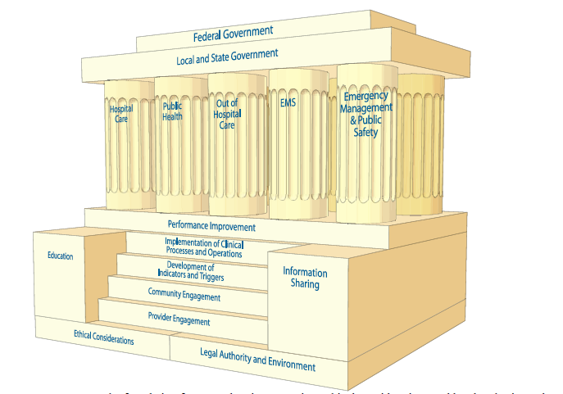
Notes:
There is a robust and complex infrastructure surrounding CSC. Many participants are involved and coordination and planning are essential.

Slide 9
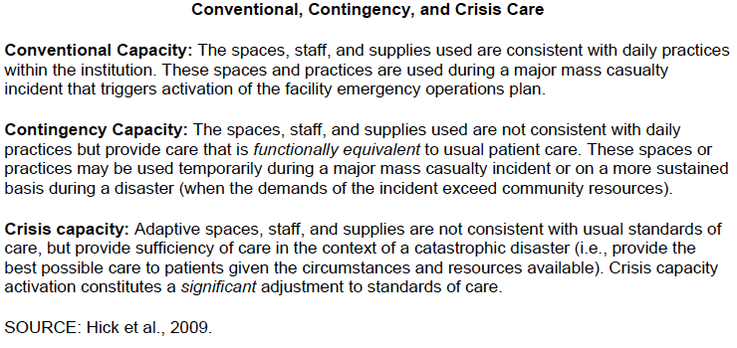
National CSC Guidelines

Slide 10
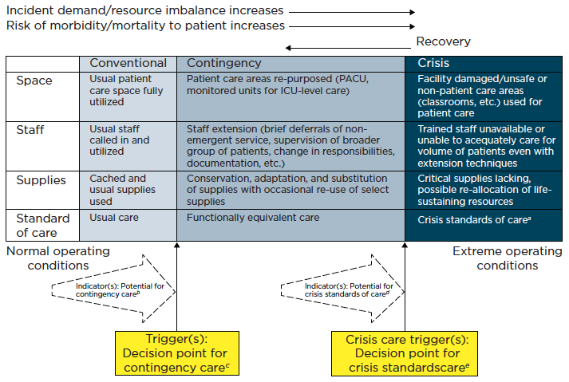
National CSC Guidelines

Slide 11
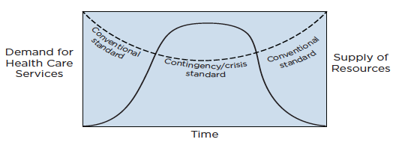
National CSC Guidelines
Notes:
The standards of care will vary over time depending on circumstances.

Slide 12
Michigan Guidelines: Applicability
Emergencies and disasters than impact public health give rise to unique challenges that can lead to, and be exacerbated by, scarcity of medical resources and services.
The likely conditions during emergencies—including conditions of medical resource and service scarcity—may be anticipated even in emergency circumstances that arise from sudden, extraordinary, or temporary events.
Emergency planners have an ethical duty to plan for and provide guidance related to the ethical allocation of scarce medical resources and services during emergencies or disasters.
Notes:
The drafting Committee identified 8 assumptions, described in the following 3 slides, that form the content of the Guidelines.
Scarcity of medical resources and services is a real concern during public health emergencies, and can occur in all sorts of ways and in all sorts of settings. Even though careful planning and stockpiling of resources can help avoid scarcity in some types of emergencies, some types of shortages, such as the limited initial availability of influenza vaccine if a new strain emerges, are unavoidable even with the best planning due to the current technological limitations on vaccine production.
Examples of scarcity of medical resources and services during an emergency may include: ventilators, medications, vaccines, beds, personnel, and general medical supplies, etc.
While the specifics of an emergency and the shortages it may create are not always predictable with certainty, a reasonable estimation of the likely emergency scenarios and shortage can be anticipated and planned for.
Therefore, a duty exists for emergency planners to provide ethical guidance for allocating scarce resources during PH emergencies. This duty extends across many levels. This set of guidelines provides a basic framework. Further development is needed at all of these levels. You will find a brief outline of the assumptions of the committee on the first page, in the executive summary section, and a more detailed description starting on pages 11-13.

Slide 13
Michigan Guidelines: Applicability
The Guidelines apply to serious emergencies and disasters, not everyday scarcity of medical resources and services (crisis standards of care apply).
The Guidelines apply to allocation decisions made by decision-makers at different levels of government as well as the private and nonprofit sectors.
The Guidelines apply to allocation decisions affecting all medical resources and services that may become scarce during an emergency or disaster.
Notes:
It is important to note that these guidelines are meant to deal only with the types of extraordinary circumstances created by public health emergencies, not everyday scarcity, since many of the recommendations would not be necessary or appropriate under normal conditions.
Since the Guidelines create a tool to assist decision-makers in their allocation decisions under situations of scarcity that may arise during a public health emergency, they apply to decision-makers in multiple settings. For example, the Guidelines can be applied to all levels of government and to both public and private sectors. Moreover, coordination between these disparate actors (national, state, regional, local, institutional, individual) is essential to an effective emergency response, so referring to the same general set of allocation standards can facilitate cooperation.
The Guidelines are meant to be applied broadly to allocation of all scarce medical resources and services during an emergency. This is a recognition that both resources and services need to be considered when weighing the effects of scarcity during an emergency or disaster.

Slide 14
Michigan Guidelines: Applicability
The Guidelines employ ethical principles that take into account both individual health and population health.
The Guidelines should be implemented in ways that comply with all relevant laws at the federal, state, and local levels
Notes:
A population health approach differs somewhat from the typical individual focus of the medical care system. There is a recognition that population level goals and needs may outweigh individual interests in some circumstances.
Legal aspects are an important component of allocation decisions. The Guidelines do not change the law or have the force of law. Rather, they complement relevant laws. These Guidelines should be implemented consistently with all relevant laws.

Slide 15
Michigan Guidelines: Goals
Minimizing morbidity, mortality, and suffering
Sustaining a functioning society
Ensuring equity
Notes:
The Guidelines identify three important goals that guide the allocation criteria. The discussion of these three goals is found on pages 14-16 in the Guidelines.
[revise]
The goal of minimizing morbidity and mortality is a health-focused goal that strives to maximize the protection of the public’s health. This is a challenge since risk is often hard to assess and systemic effects during a complex emergency are even harder to assess.
The Guidelines recommend employing science-based criteria and making allocation decisions based on prognosis of a favorable health outcome.
The goal of maintaining the social fabric is a broad goal that is in many ways beyond the control of this guidance. Two main issues arise: 1) supporting critical infrastructure, including the protection of essential personnel, and 2) upholding trust and cooperation from the public. The first issue may support provision of priority access to certain essential personnel to ensure their necessary skills are still available to help others. The second issue is vital to maintaining support and cooperation from the public at large.
The Guidelines recommend identifying specific groups essential to societal functioning and prioritizing access for these groups to scarce medical resources and services. Also, the Guidelines recommend providing the public with information, creating opportunities to engage with and comment on allocation guidelines, developing transparent and accountable processes, and alerting the public to any changes in advance of an emergency.
The goal of ensuring equity is based on a recognition that all people are morally equal, yet understanding that fair access does not always mean equal access. Fairness may be in tension with the other two goals but may also complement them.
The Guidelines recommend outlining fair procedures for allocation decision, limiting the use of some types of allocation criteria to avoid discrimination based on demographic or instrumental factors, endeavoring to reduce disparities in access, and providing the highest level of medical care possible under the circumstances, including palliative care.

Slide 16
Michigan Guidelines: Ethical Considerations
Beneficence
Utility
Fairness (procedural justice and distributive justice)
Equity
Transparency
Accountability
Trust
Respect for persons
Proportionality
Solidarity
Reciprocity
Stewardship
Veracity
Notes:
A number of ethical considerations were applied to the issues raised by these Guidelines. Each of these considerations is described on pages 17-18 of the Guidelines.

Slide 17
Michigan Guidelines: Allocation Criteria
Acceptable Allocation Criteria:
Medical prognosis
Supporting critical infrastructure
Situation-Dependent Allocation Criteria:
Lottery
First Come/First Served
Age
Unacceptable Allocation Criteria:
Social characteristics
Social worth
Notes:
The Guidelines present three categories of allocation criteria. These three categories are marked by the three colors of a traffic light.
A green light indicates the acceptable allocation criteria; those criteria describing factors which a decision-making entity would be justified in using to decide questions of allocation.
A yellow light indicates a set of situation-dependent allocation criteria. These criteria may be considered by decision-makers under some circumstances, but each of these criteria has inherent flaws that concerned the committee.
A red light indicates unacceptable allocation criteria; criteria which should not be used to make allocation decisions. Many of these criteria raise the possibility of abuse, discrimination, and prejudice.
The full discussion of these allocation criteria can be found on pages 19-23 in the Guidelines.

Slide 18
Acceptable Allocation Criteria
Medical prognosis:
patient’s medical condition,
the likelihood of a positive medical response,
the relative risk of harm posed by not treating the patient,
other indicia of survivability and favorable medical outcomes.
Notes:
The first green light criterion is a patient’s medical prognosis. Assessment of a patient’s medical prognosis takes into account the medical condition of the patient, the likelihood of a positive medical response, the relative risk of harm posed by not treating the patient, and other indicia of survivability. This criterion supports the goal of reducing morbidity and mortality and is consistent with the ethical principles of beneficence, utility, and stewardship.

Slide 19
Acceptable Allocation Criteria
Supporting critical infrastructure:
Workers that perform essential functions that support critical infrastructure
Notes:
The second acceptable allocation criterion is to prioritize those with certain essential social functions. This approach potentially has a double benefit: essential workers themselves are protected and they can continue to serve others. The categories must be narrow to ensure public support and avoid preferential treatment. As a general rule, it is not fair to use measurements of social worth (such as a person’s profession) to make allocation decisions, however, to ensure the minimal loss of life during a public health emergency this exception to the general rule is considered acceptable.

Slide 20
Acceptable Allocation Criteria
Essential personnel may include:
health care workers who are directly treating patient affected by the emergency or disaster(doctors, nurses, behavioral and mental health professionals, etc.);
personnel key to responding to the emergency or disaster (first responders, public health scientists, etc);
personnel key to public safety (police, fireman, military, etc.); and
personnel key to critical infrastructure (energy grid , telecommunications, food access, etc.).
Notes:
This slide includes the list of essential personnel identified by the committee as potentially justifying preferential access to scarce resources and services. Other groups could also be added to this list, but the list cannot be extended too much without undermining its limited goals of only prioritizing personnel who are truly essential. The committee, for example, discussed but did not recommend including government officials or people with caretaker responsibilities as essential personnel.

Slide 21
Situation-Dependent Allocation Criteria
Lottery
Fair and random opportunity
Not conducive to minimizing morbidity or mortality, stewarding resources, or advancing equity
Complex to administer, and could be manipulated
Notes:
The other two situation-dependent criteria are both types of random allocation. Lotteries are fair and random, and therefore not discriminatory. But a lottery is not a targeted tool for the best outcomes or the most effective use of resources. Using a lottery system takes the control or mitigation efforts out of the hands of people, and potentially places outcomes on pure chance.
Lotteries can be difficult to administer. Detailed rules may have to be negotiated (for example, can you give your place in the lottery to someone else?).
Lotteries may be most appropriate to use as a tie breaker in some circumstances, as a means of allocating resources once other allocation measures have been applied or are inapplicable.

Slide 22
Situation-Dependent Allocation Criteria
First come/first served
Easy to administer and wide accepted
Not truly fair since favors those with built-in advantages
Notes:
The first come/first served approach also seems random on its face, but its implementation is highly influenced by social factors. This approach is easy to implement because it is already the standard of care under normal circumstances. But this approach it does not comport with ethical considerations of fairness and justice since it favors those with informational or economic advantages.
Not using a first come/first served model may present particularly hard problems for decision-makers, especially those involved in providing certain services like EMT. Do you reject calls to wait for more serious calls?

Slide 23
Situation-Dependent Allocation Criteria
Age
Fair innings: prioritize younger
Problems of measuring age
Age discrimination
Notes:
The yellow light allocation criteria apply in situation-dependent circumstances. These allocation criteria may sometimes be appropriate to use in allocation decision-making, but should only be employed with caution.
The criterion of age raises several issues. Some have argued that younger people should take precedence over older people. The fair innings argument, for example, states that everyone should have the opportunity to live a full life, and to experience all of the stages of life.
There are many ways age could be used (pure chronological age, QALYs, DALYs). Using age as a determinative factor is problematic because chronological age is a crude tool to differentiate people. But it does avoid qualitative judgments on the quality or value of one’s life. The other approaches, quality-adjusted life years or disability-adjusted life years (QALY and DALYs) do make qualitative judgments, but introduce other factors such as a persons disability status which may be problematic.
Each of these approaches has potential problems, including problems of age discrimination.
Granting priority to access scarce medical resources or services based on numerical age, quality-adjusted life-years, disability-adjusted life-years, or some other measurement based upon longevity or functioning raises several difficult issues. It may be fair to allow a younger person to have the chance to live to an older age, given that older people have already had the opportunity to experience those phases of life. But this approach goes against equality in the sense that it is making an explicit differentiation between people based on numerical age. Due to these concerns, the Committee recommends that age may only be used as a factor for scarce resource allocation in the very rare circumstances where no other approach will suffice to differentiate between similarly situated individuals and such an approach has received public approval and does not offend notions of fairness and equity. In some cases, prioritization of scarce resource based on age range may be acceptable to meet public health policy goals, such as prioritizing older adults for access to limited COVID-19 or influenza vaccine if supported by morbidity and mortality data. Any use of age to differentiate between individuals or groups to prioritize access to resources must comply with relevant anti-discrimination laws.

Slide 24
Unacceptable Allocation Criteria
Social characteristics
Age, color, criminal history, disability, ethnicity, familial status, gender identity, height, homelessness, immigration status, incarceration status, marital status, mental illness, national origin, poverty, race, religion, sex, sexual orientation, socio-economic status, substance use disorder, use of government resources, veteran status, or weight
Improving equity
Notes:
These red light criteria are not acceptable because of their inherent lack of fairness, potential for abuse or discrimination, or irrelevance to achieving the stated goals.
Social characteristics like these have often been used as a pretext for favoritism, discrimination, and reduced access for minority groups.
Social characteristics, including but not limited to age (with very limited exceptions), color, criminal history, disability, ethnicity, familial status, gender identity, height, homelessness, immigration status, incarceration status, marital status, mental illness, national origin, poverty, race, religion, sex, sexual orientation, socio-economic status, substance abuse disorder, use of government resources, veteran status, or weight, should not be used as a basis to deny or justify a lesser priority to access scarce resources or services during emergencies or disasters. Categorization of people according to these types of characteristics is often used as pretext for favoritism, discrimination, and reduced access for minority groups. Therefore, use of social characteristics as allocation criteria is unacceptable, unless such characteristics are being considered as part of a deliberate effort to improve equity in access to scarce resources such as application of the CDC’s Social Vulnerability Index or the Area Deprivation Index.

Slide 25
Unacceptable Allocation Criteria
Social worth
For example, job status, training or education, social standing, relationships or affiliations, ability to pay
Limited exception for essential personnel
Notes:
Social worth criteria can lead to unfair decisions based on subjective determinations of a person’s background or characteristics, which can lead to stigma, bias, greed, or nepotism.
As noted previously there is a limited exception made for essential personnel, whose occupations serve a community interest in mitigating morbidity and mortality or maintaining essential infrastructure in a time of emergency.
Financial or economic consequences of a person’s ability to pay are also not acceptable criteria.
The discussion of acceptable allocation criteria recognizes that limited categories of people who provide specific social functions, namely groups of identified essential personnel, may be granted priority access to scarce resources and services during an emergency or disaster. However, beyond these limited categories, factors that take into account a person’s social worth are not acceptable to consider for allocation decisions. Social worth criteria are generally unacceptable because they can lead to unfair decisions based on subjective determinations of a person’s background or characteristics, which can in turn lead to stigma, bias, corruption, or nepotism in allocation decisions. Unacceptable factors under this category would include but are not limited to job status, training or education, social standing, personal or familial relationships, belief systems, political affiliations, or any other measurement of a person’s social standing. In particular, the Committee found unacceptable any sort of decision-making process that considered a person’s ability to pay for medical resources or services as relevant to prioritizing resources or services. Similarly, it would be inappropriate for providers of medical resources and services to consider the financial or economic consequences of a person’s ability to pay in making allocation decisions for scarce medical resources or services unless such considerations are being made to improve equity in access to scarce resources.

Slide 26
Implementation
Avoiding scarcity
Assessing probability, nature, duration, and severity
Process
Transparency
Consistency
Review and reassessment
Decision-making
Palliative care
Notes:
The Guidelines offer a number of recommendations related to the implementation of the allocation criteria.
Scarcity of medical resources and services should be avoided whenever possible, rendering the application of these Guidelines unnecessary.
Assessing the extent and scope of scarcity is a key step in implementation and can also raise questions of alternative strategies for resource allocation. These Guidelines should not be read to alter or subvert efforts to create or maintain emergency stockpiles or other efforts to prevent loss of life or avoid scarcity for to an emergency.
Processes for developing allocation strategies and the implementation of these strategies should be fair and transparent. Appeals should be available for patients who disagree with the allocation decisions of decisions-makers.
The Guidelines should be interpreted and applied consistently across the state of Michigan. However, local decision-makers may need to deviate under some circumstances, but all decisions on allocation should adhere to the ethical principles stated within the Guidelines.
Decision making should be made removed from the clinical context in order to minimize conflicts of interest and difficult interactions. This allows for population level considerations to be taken into account, promotes consistency, and removes pressure from individual practitioners.
There is an expectation under these Guidelines that the highest available level of care will be provided to any person in time of emergency.
Palliative care should be provided to anyone who is not given access to scarce medical resources or services in order to minimize pain and suffering. This may include pain management, symptom alleviation, and emotional support services.

Slide 27
Specific Guidance
Prehospital entities (EMS and Medical Control Authorities)
Hospitals and health care facilities
Legal issues
State and local government (including public health)
Long-term care settings
Others?
Notes:
A number of attachments have been developed to provide more specific guidance to those addressing allocation decision within certain settings. Annex 1 addressing EMS and Medical Control Authorities and Annex 2 addressing hospitals and health care facilities will be of particular usefulness to hospitals and first responders.
The legal attachment, Annex 3, explains the relevant legal provisions under federal and state law that apply to the allocation decisions discussed in the Guidelines.
Additional materials are in the works, including one to provide specific guidance to local public health. These other materials will be made available on a rolling basis, and released periodically as attachments to the overall guidelines once completed.

Slide 28
Indicators, triggers, and tactics
Outlines factors and scenarios that can implicate contingency or crisis standards of care
Provides possible tactics to mitigate or avoid scarcity
Addresses slow-onset and no-notice emergencies
Addresses various categories of potential scarcity
Notes:
The Specific Guidance also contains a detailed table of indicators, triggers, and tactics. The table provides information that will assist state and local government officials in identifying and tracking indicators and triggers that suggest when scarcity conditions may require different approaches and strategies to sustain operations and provide services. As the situation moves across a continuum of care, from conventional care to contingency care to crisis care and back again, these tables provide tactics to mitigate the impacts of scarcity across a number of types of resources, including surveillance data, communications infrastructure, community infrastructure, staff, space, supplies, fatality management, and congregate gatherings. The table also distinguishes indicators, triggers, and tactics between slow-onset scenarios, like an infectious disease pandemic, and no-notice scenarios, like an earthquake or major power outage.
Hospital guidance covers
Guidance for Staffing
Guidance for Medication Administration
Guidance for Mechanical Ventilation
Guidance for Pediatrics
Guidance for Palliative Care
Guidance for Extra-Corporeal Membrane Oxygenation (ECMO) in Michigan

Slide 29
Next steps
Public engagement
Training and tabletop exercises
Education materials
Targeted review
Website
Public feedback
Notes:
These meetings represent an important stage in developing the Guidelines. Your feedback will provide further insight into any changes or concerns held by the larger community. Your input is invaluable in determining how scarce resources will be allocated during public health emergencies in the state of Michigan. Thank you for your time and we welcome your comments and discussion.

Slide 30
Discussion?

