Slide 1
Region 6 HCC
Medical Response and Surge Exercise
October 27, 2022
Via MS TEAMS (Virtual)

Slide 2


Slide 3
Purpose
The Medical Response & Surge Exercise (MRSE) was created by the U.S. Department of Health and Human Services (HHS) Administration for Strategic Preparedness and Response (ASPR). The exercise procedures and supporting materials described in the Situation Manual (SitMan) and this Evaluation Plan are aligned with updated the Federal Emergency Management Agency (FEMA) Homeland Security Exercise and Evaluation (HSEEP) guidelines issued in 2020. MRSE is a functional exercise, which HSEEP describes as “an operations-based exercise designed to test and evaluate capabilities and functions while in a realistic, real-time environment.”

Slide 4
Purpose
The purpose of the MRSE is to provide HCCs and their members with an opportunity to test their surge response and preparedness capabilities. The scenario used in the MRSE is defined by the HCC, but all exercises will test an HCC and its members’ capacity to accommodate a surge of patients equal to at least 20% of its staffed bed capacity3 3 Only certain bed types are included in this calculation. Additional bed types may be included based on the incident scenario defined by the HCC. The accompanying Exercise Planning and Evaluation Tool will calculate the number of patients based on inputs from the HCC. and to ensure availability of staffed beds, supplies and equipment, and personnel across its membership.

Slide 5
Surge Definition
Surge capacity is the ability to manage a sudden influx of patients. It is dependent on a well-functioning incident command system (ICS) and the variables of space, supplies, and staff. The surge requirements may extend beyond placing patients into beds and should include all aspects related to clinical services (e.g., laboratory studies, radiology exams, operating rooms).
Surge capability is the ability to manage patients requiring very specialized medical care. Surge requirements span a range of medical and health care services (e.g., expertise, information, procedures, or personnel) that are not normally available at the location where they are needed (e.g., pediatric care provided at non-pediatric facilities or burn care services at a non-burn center). Surge capability also includes special interventions in response to uncommon and resource intensive patient diagnoses

Slide 6
Objectives
Assess
Assess an HCC’s capacity to support a large-scale, community-wide medical surge incident
Evaluate
Evaluate a multitude of coalition preparedness and response documents and plans, including specialty surge annexes, transfer agreements, coordination plans with another state HCCs, and all other relevant plans
Evaluate
Evaluate coalition members’ ability to communicate and coordinate quickly to find and match available staffed beds, transportation, supplies and equipment, and personnel during a large-scale surge incident
Assist
Assist HCCs and their members with improvement planning based on MRSE outcomes
Serve
Serve as a data source for performance measure reporting required by the HPP Cooperative Agreement
Provide
Provide a flexible exercise that could be customized to meet the needs and/or exercise requirements of HCCs

Slide 7
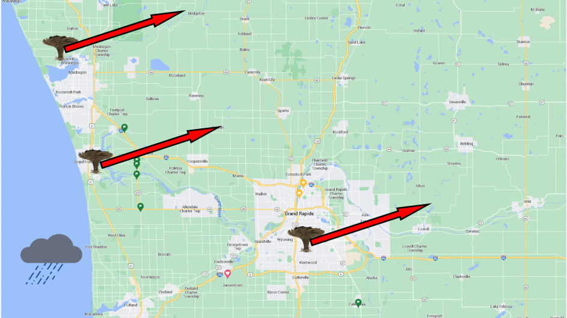
Scenario
Major Storm
Tornado strike in Kent, Ottawa and Muskegon counties.
Large number of patients.
All facilities will be fully functioning.

Slide 8
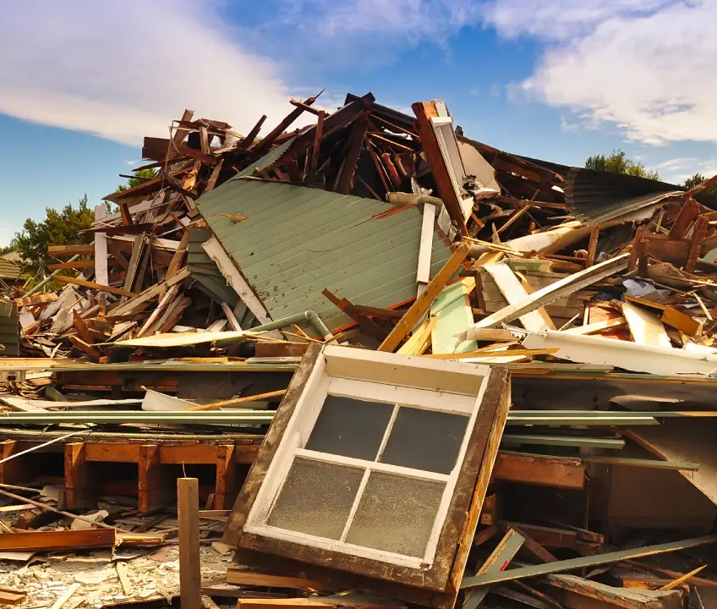
Simulation
20% surge of staffed beds in Acute Care Hospitals.
Coordination between all coalition members.
Identify gaps in communication and needs.
Identify best practices in your own facility.

Slide 9
Exercise Outcomes
The HCC has validated all applicable response plans and identified gaps that remain unaddressed.
The HCC is better prepared to respond to a large-scale surge in patients.
HCC members have improved their capacity to assess the availability of and secure access to key resources such as staffed beds, personnel, supplies and equipment, and patient transport during a large-scale community incident.
The HCC has strengthened its role in sharing information, situational awareness, and coordination during a large-scale community incident.

Slide 10
Review Discussion Questions
Plan & Scope
Did all contacted members confirm their availability to participate in the exercise?
Will HCC members be using the exercise to meet other requirements? If so, which?
a. Joint Commission
b. CMS
c. PHEP
d. EMS-related exercise requirements
e. Other (please specify)

Slide 11
Review Discussion Questions
Incident Recognition
How is the HCC notified?
Identify Initial Incident Details
  What, When, Where
  Responding units
  Reported injuries (approx. # & type)
Identify Current Operating Conditions:
  Weather
  Traffic
  Other factors impacting operations

Slide 12
Review Discussion Questions
Notification
What is the primary and secondary system utilized to notify and activate an HCC response?
What is the process used to notify and mobilize your support team?
What were the primary and secondary systems utilized to alert HCC members?

Slide 13
Review Discussion Questions
Mobilization
If applicable, what positions are part of your HCC’s incident management team during the exercise?
If applicable, what positions were activated for this response?
How long did it take for you to activate your support team?
Were there any barriers/issues with notification/activation/mobilization?

Slide 14
Review Discussion Questions
Incident Operations
Were all planned/expected members of your incident management team able to participate in the exercise?
Were any barriers faced that would hinder participation?

Slide 15
Review Discussion Questions
Information Sharing
Which incident reporting system/sharing platform is used by the CC to collect and share information (e.g., CST 2.0 tool to provide dropdowns of known systems with options for others)?
Who maintains this system?
Who from the HCC has access to the system?
What process do you use to manage ongoing requests for information HCC members and other stakeholders?

Slide 16
Review Discussion Questions
Resource Coordination
Describe the process used to manage and coordinate resources(staff, supplies, equipment, etc.)
What process do you use to manage requests for resources for HCC members and other stakeholders?
What process do you use to facilitate the management and distribution of resources across HCC members?

Slide 17
Review Discussion Questions
Patient Tracking
Was mutual aid required? Were there any issues or concerns?
What additional resources does EMS require (staff, equipment, etc.) to care for and transport patients?
Based on the chosen scenario, what is the estimated EMS response time?
What is the process for EMS to provide updates to hospitals?
Who is responsible for determining patient transport locations?
Based on the chosen scenario, what is the estimated time that takes EMS to triage and transport all patients to a receiving facility?

